Slide 1
Company and Marketing Strategy
Chapter 2

Slide 2
Objectives
Introduction
What is Strategic planning ?
Business portfolios and growth strategies
Explain Marketing’s Role in Strategic Planning
Describe Marketing Mix
4 Ps vs. 4 Cs
Conclusion

Slide 3
Marketing Strategy
What is marketing strategy?
The process of developing and maintaining a strategic fit between the organization’s goals, capabilities and its changing marketing opportunities.
Notes:
1867: Billboards/posters
1922: Radio advertising begins
1954: TV ads
1970: Telemarketing
1972: Magazines
1995: the Dot.com Bubble
1998: Blogging emerge
2003: Social Media Begins
2011 till Now: Smartphones and the impact of Social Media

Slide 4
Steps of Strategic Planning
Define the company mission
Set company objectives and goals
Design the Business portfolio
Plan marketing and other functional strategies
Corporate Level
Business unit, product and market level
Fig 1: The steps of strategic planning

Slide 5
Mission and Vision
MISSION: A statement of the organization’s purpose. It should be market oriented and define customer needs
VISION: A statement explaining what the company want’s to be (Forbes, 2012)

Slide 6
A MARKET-ORIENTED MISSION

Slide 7
A MARKET-ORIENTED MISSION
A mission statement should ask: What is our business, Who is the customer, What do consumers value and What should our business be?
The mission should be:
Realistic.
Specific.
Motivating
Fit the market environment.
Based on distinctive competencies.
Notes:
– state of felt deprivation.
Wants- needs shaped by individual personality and culture
Demands- wants backed by buying power

Slide 8
THE BUSINESS PORTFOLIO
The business portfolio is the collection of businesses and products that make up the company.

Slide 9
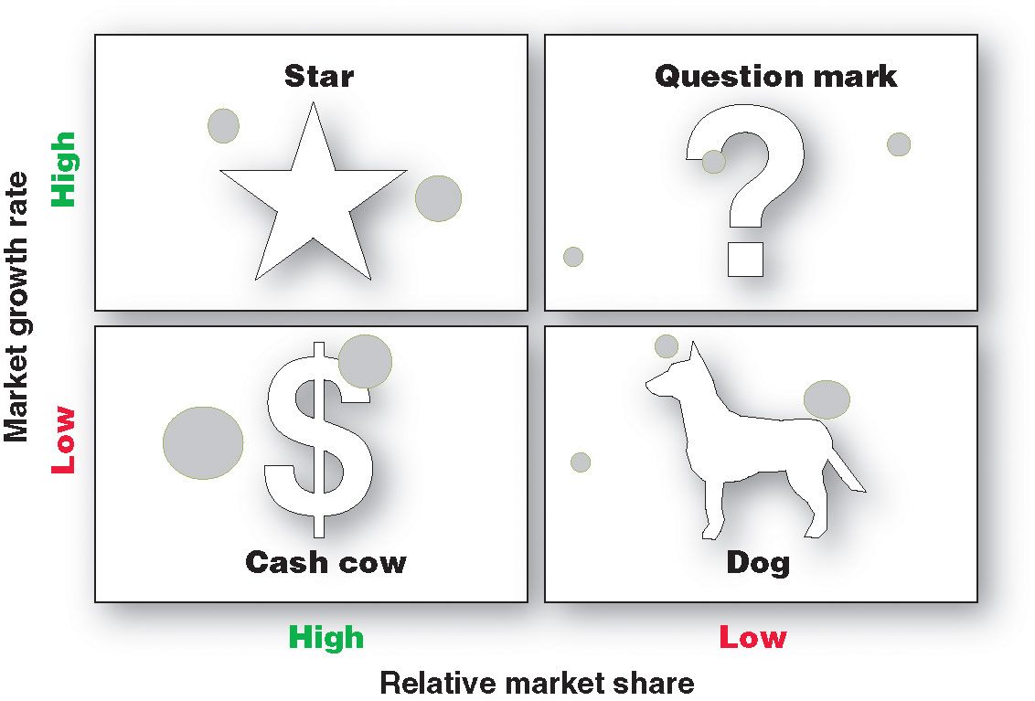
The Boston Consulting Group (BCG) Matrix

Slide 10
The Boston Consulting Group Approach
Build：
It can invest more in the business unit.
Hold:
It can just enough to share at the current level.
Harvest：
It can harvest the SBU, milking its short-term cash.
Divest：
It can divest the SBU by selling it or phasing it out and using the resources elsewhere.

Slide 11
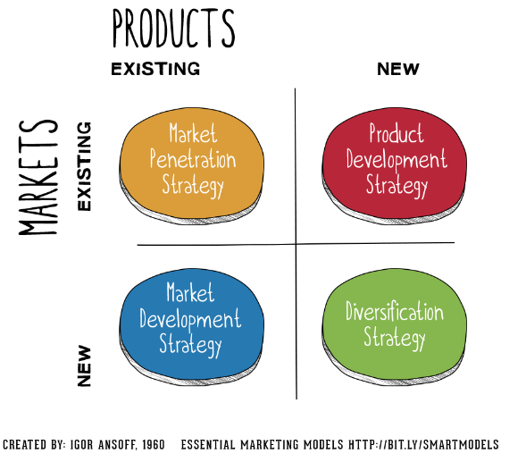
PRODUCT /MARKET EXPANSION GRID

Slide 12
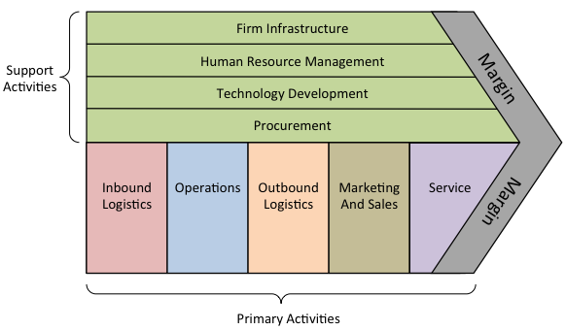
Value Delivery Network

Slide 13
Marketing Strategy and Marketing Mix
Customer Driven marketing strategy involves:
Market segmentation
Market targeting
Differentiation
Positioning

Slide 14
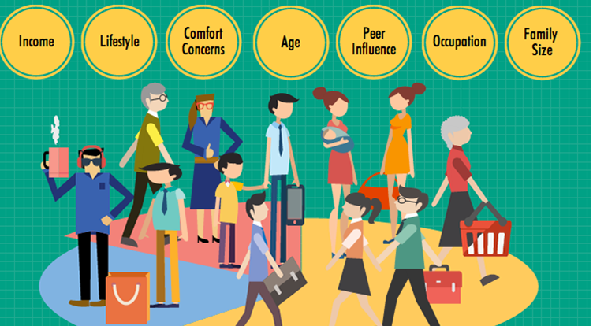
MARKET SEGMENTATION

Slide 15
Target Marketing

Slide 16
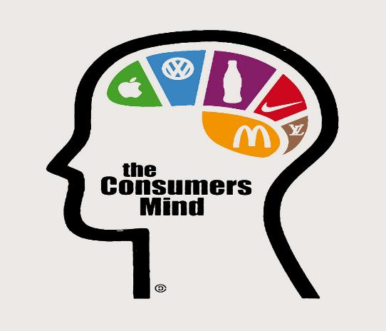
Market Positioning-What place you want to take in the consumers’ mind

Slide 17
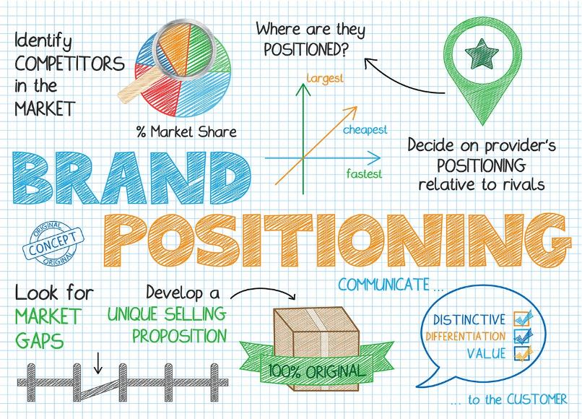

Slide 18
Developing an Integrated Marketing Mix
4Ps
Product
Price
Place
Promotion
4Cs
Customer solution
Customer cost
Convenience
Communication

