Slide 1
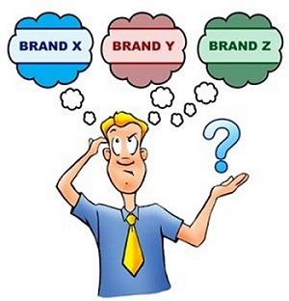
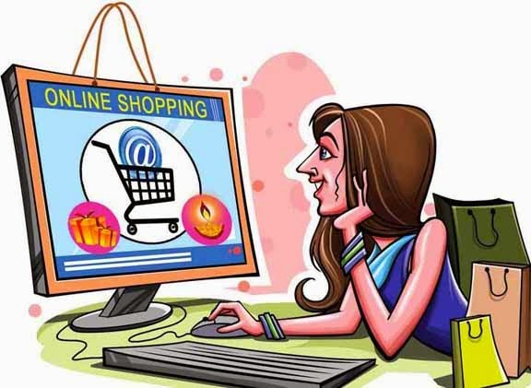
Consumer Markets and Consumer Buyer Behavior
Chapter 5

Slide 2
Topics to Discuss
Model of consumer behavior
Characteristics affecting behavior
Types of buying decision behavior
The buyer decision process
The buyer decision process for
new products

Slide 5
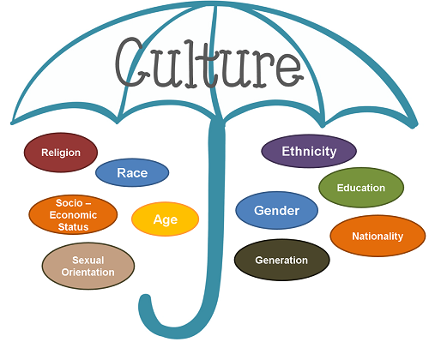
Cultural Factors
Culture
Subculture
Social Class

Slide 6
Social Factors
Reference Groups
Family
Roles and Status

Slide 7
Word-of-mouth and Buzz Marketing
Opinion leaders:
Who are they?
What can they do?
Why are they important?
Buzz/Viral marketing
Online Social Networks
Online communities
Blogs
Social networking sites (Facebook)
Virtual worlds (second life)

Slide 8
Social Factors
Family: one of the most
important consumer
buying organization
in society
Social roles and status: Behaving according to roles and responsibilities

Slide 9
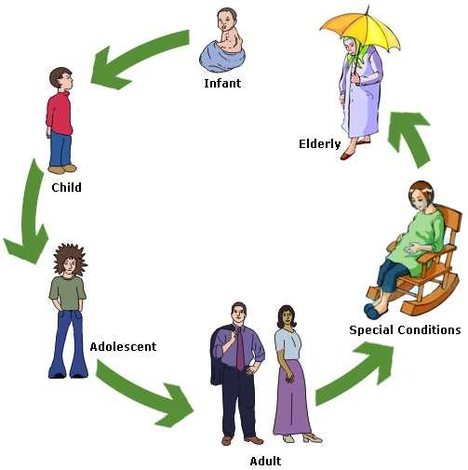
Personal Factors
Age and Lifecycle : Changes over life-time
Biological Age
Age Cohort
Economic situation
Personal Income
Savings
Interest rates
Occupation: Affects the goods and services
bought by consumers

Slide 10
Personal Factors
Lifestyle
Pattern of living as expressed in someone's psychographic
AIOs (activities, interests, opinions) to capture information about a person’s pattern of acting and interacting in the environment
Personality
Brand Personality

Slide 11
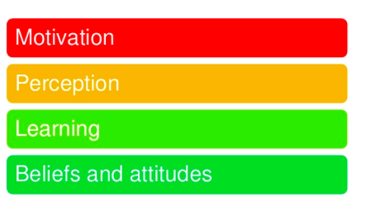
Psychological Factors

Slide 12
Psychological Factors
Motivation
A motive is a need that is sufficiently pressing
the person to seek satisfaction-A drive to do something.

Slide 13
Maslow’s Hierarchy of Needs

Slide 14
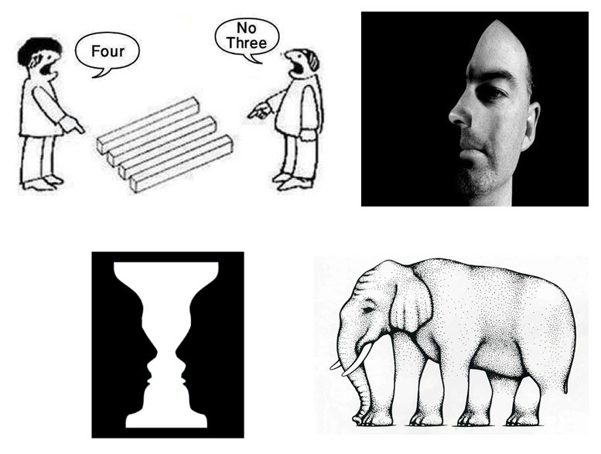
Psychological Factors
Perception: The process by which people select, organize and interpret information to form a meaningful picture of the world.

Slide 15
3 Perceptual Processes of Consumers
Selective attention: tendency to screen out most of the information
Selective distortion: tendency to interpret information in their own way
Selective retention: consumers remember good points made about a brand

Slide 16
Types of Buying Behavior

Slide 17
The buyer decision process

Slide 18
Buyer Decision Process for New Products

Slide 19
Factors that speed up the rate of adoption

Slide 20
Adopter Categories

