Slide 1
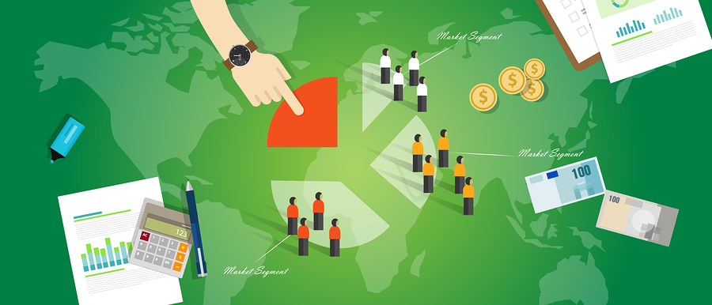
CUSTOMER DRIVEN MARKETING STRATEGY

Slide 2
objectives
Customer driven marketing strategy
Market segmentation
Market targeting
Differentiation and positioning

Slide 3
Designing a customer driven marketing strategy

Slide 4
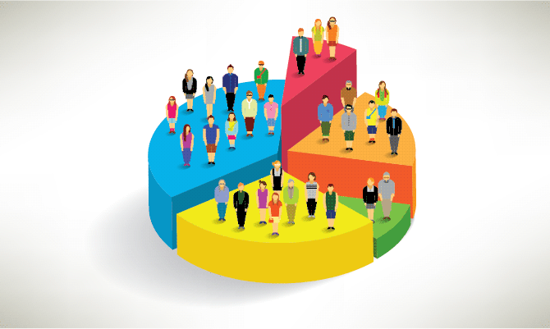
Market segmentation
Segmentation:

Slide 5
Market segmentation

Slide 6
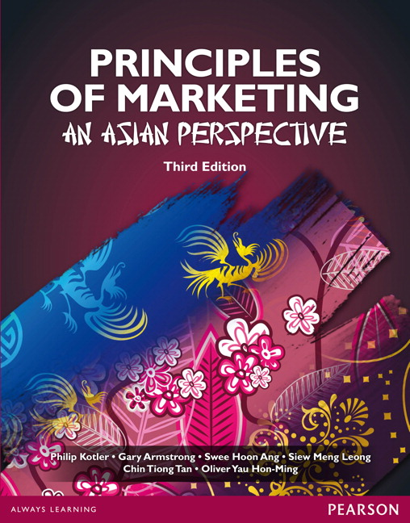
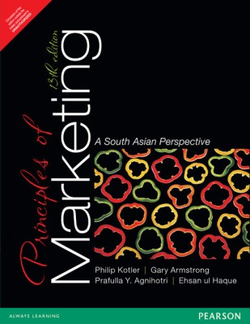
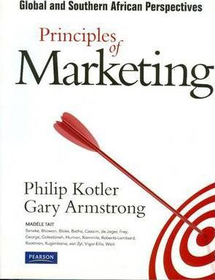
Geographic Segmentation
Region
Countries
Cities
Neighbourhoods

Slide 7
Geographic Segmentation

Slide 8
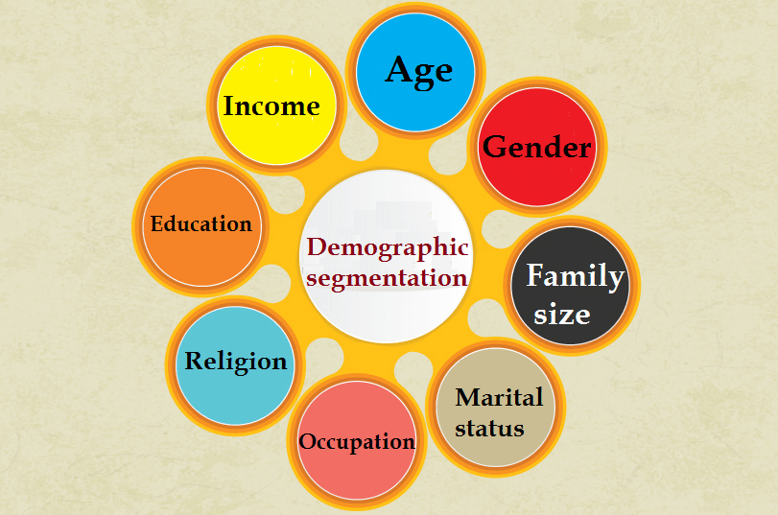
Demographic Segmentation

Slide 9
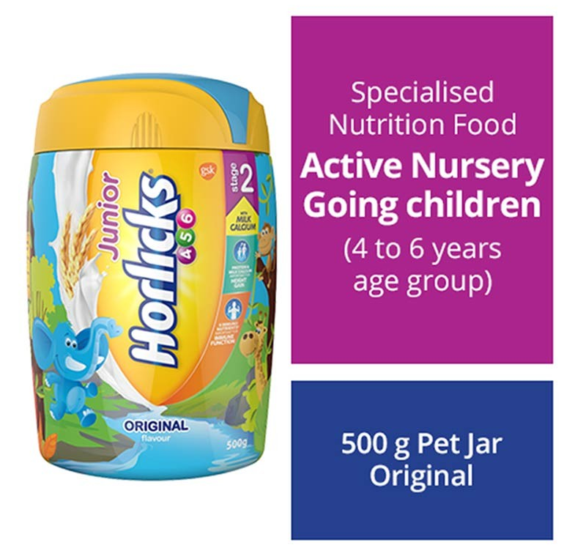

Slide 10
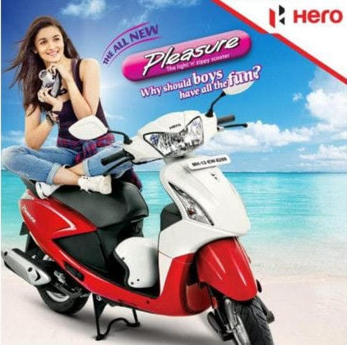

Slide 11
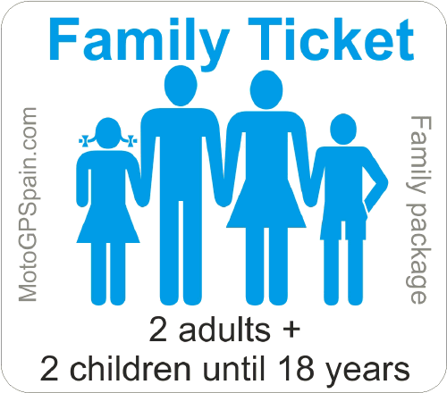
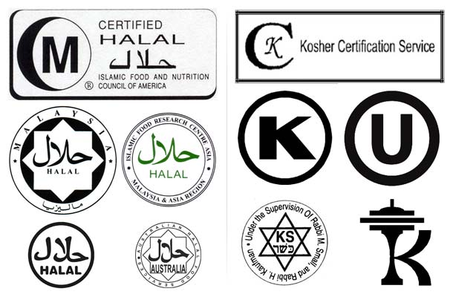

Slide 15
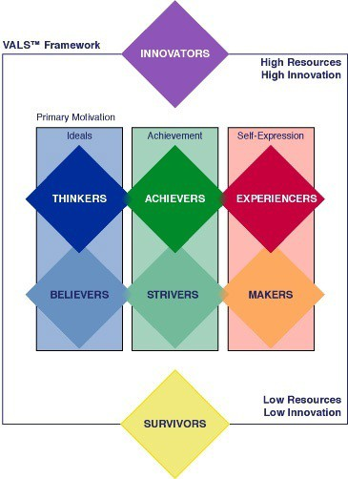
Psychographic segmentation:

Slide 16
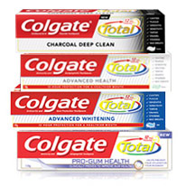
Behavioral Segmentation:
Factors to consider:
Occasions
Benefits sought
User status
User rate
Loyalty status

Slide 17
Market segmentation

Slide 18
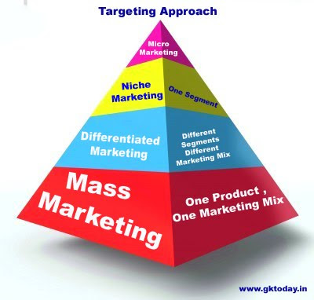
targeting

Slide 19
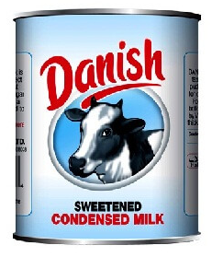
Mass Marketing-Same thing for everyone

Slide 20
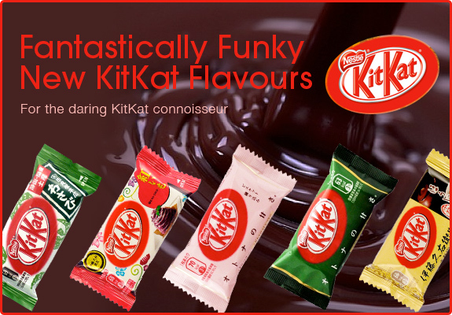
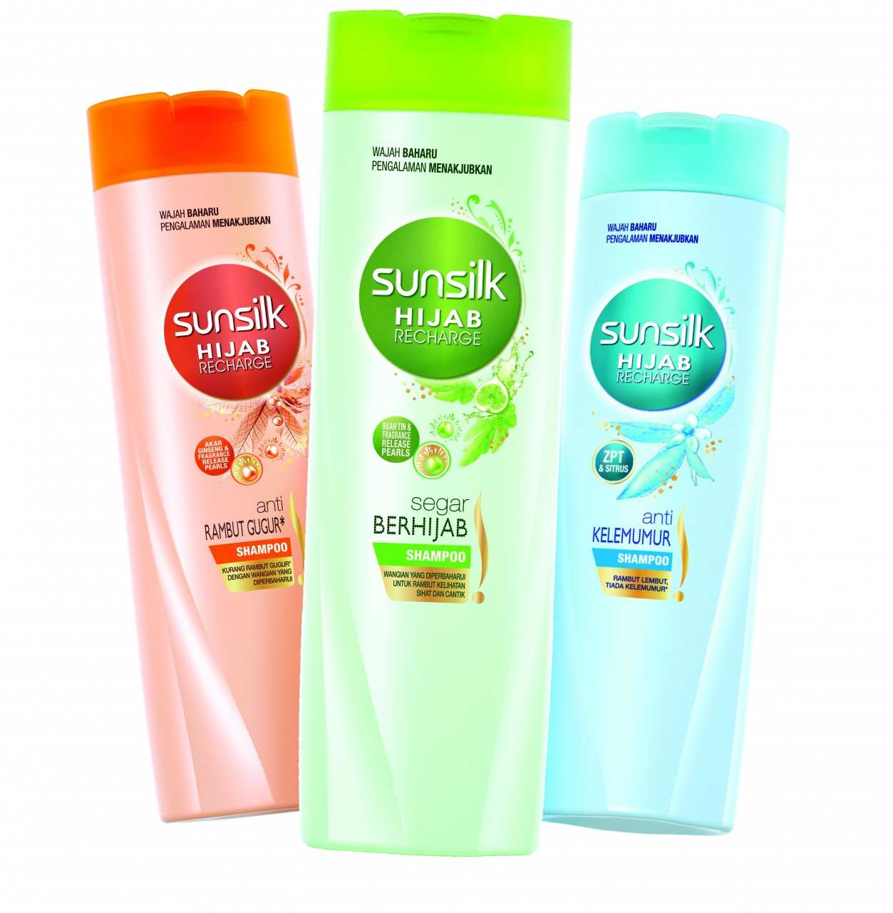
Differentiated marketing-different things for different people

Slide 21
Niche marketing-special things for special people

Slide 22
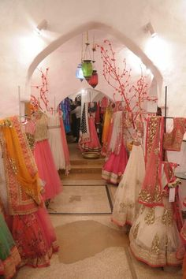
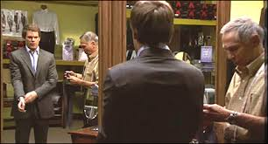
MICRO-marketing-customized options
Local or Individual marketing:
Involves tailoring products and marketing programs to the needs and preferences of individual customers.
Also known as:
One-to-one marketing
Mass customization
Markets-of-one marketing

Slide 23
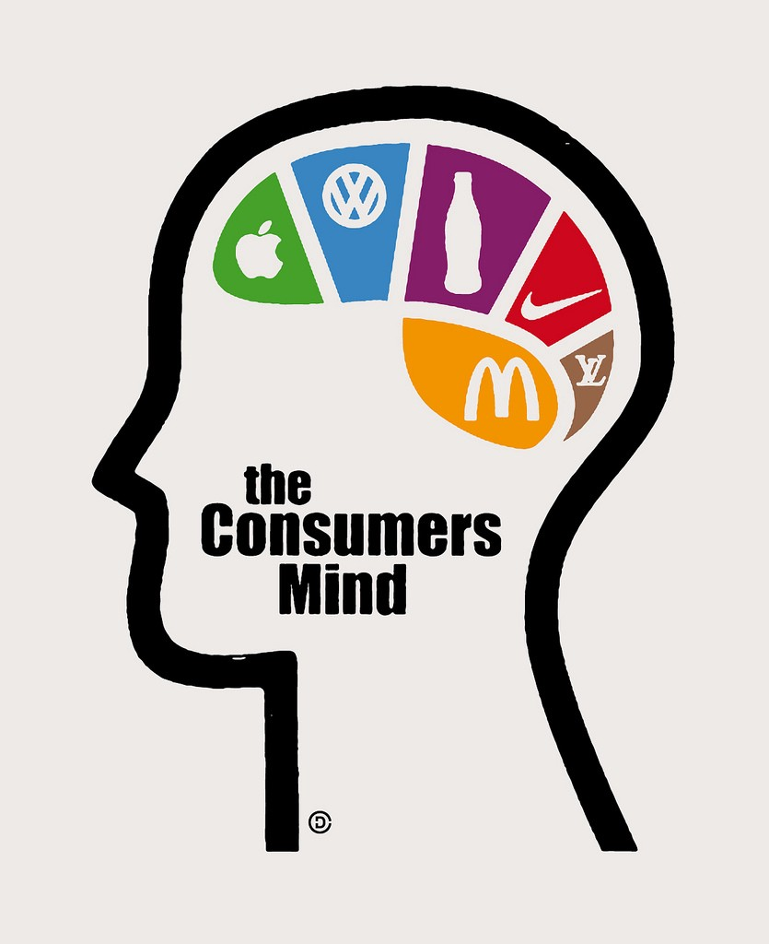
POSITIONING
Product position is the way the product is defined by consumers on important attributes.
- the place the product occupies in consumer’s mind relative to competing products
- perceptions, impressions, feelings

Slide 24
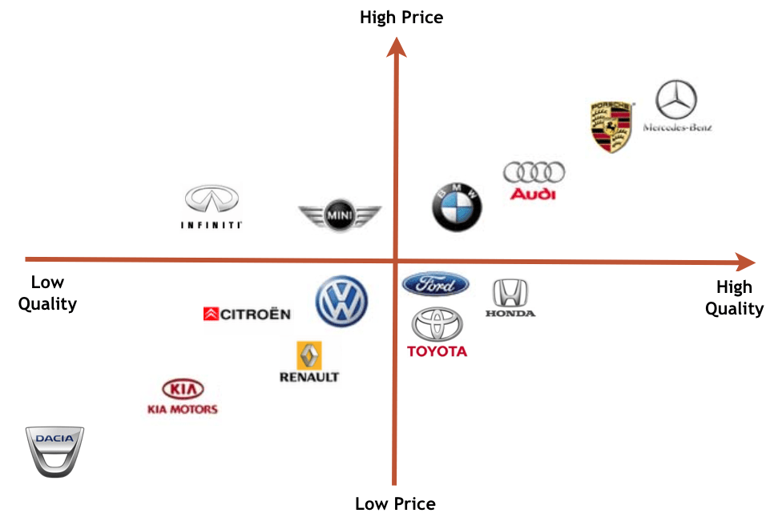
POSITIONING MAPS
Positioning maps show consumer perceptions of their brands versus competing products on important dimensions.

Slide 25
Selecting an Overall Positioning Strategy

