Slide 1
CHAPTER 8 Products, services, brands: Building customer value

Slide 2
OBJECTIVES
What is product?
Product and service decisions
Branding strategy: building strong brands
Services marketing

Slide 3
Product:
Anything offered in market for attention, acquisition, use or consumption that might satisfy a need or want
Pure tangible good: soap, toothpaste
Services:
Form of product, essentially intangible
Consist of activities, benefits or satisfaction offered for sale
Don't result in ownership of anything
Pure service: a doctor’s exam
Experiences:
What buying the product or service will do for the customer

Slide 4
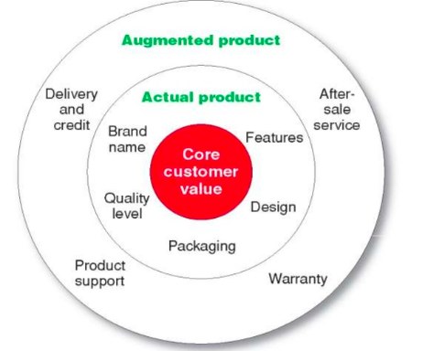
Levels of product and service
Consumers see products as complex bundles of benefits, that satisfy their needs.

Slide 5
Product and service classifications

Slide 6
Consumer products:
Products bought by final consumers for final consumption
Convenience products
Shopping products
Specialty products
Unsought products

Slide 7
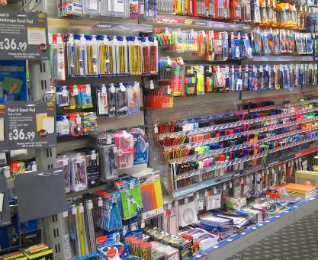

Slide 8
Shopping products are consumer products and service that customer compares carefully on suitability, quality, price and style.
Eg: Home Appliances, Clothes, Sportshoes

Slide 9
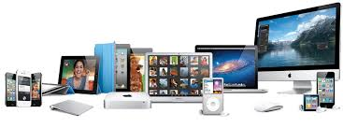

Slide 11
Materials and parts: fruits vegetables, or component materials (eg: iron, cement)
Capital items: installations and accessory equipment (buildings for offices, generators, fax machines)
Supplies and service: paint, nails, pencils

Slide 12
Organization marketing:
Sell the organization itself
Consists of activities undertaken to create, maintain or change attitudes and behaviors of target consumes toward an organization
Business firms: sponsor PR or corporate image advertising campaigns to polish their images and market themselves.

Slide 13
Person marketing:
Activities undertaken to create, maintain or change attitudes and behavior of target consumers towards particular people or to build reputation
Place marketing:
Activities undertaken to create, maintain or change attitudes and behavior of target consumers toward particular places or destinations.

Slide 14
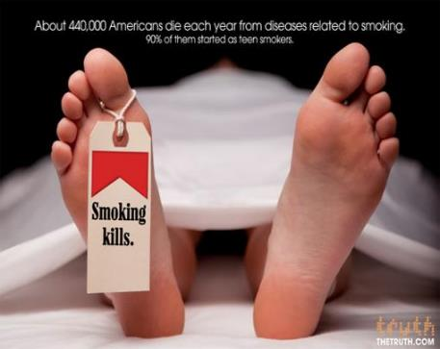
Social marketing:
Use of commercial marketing to influence individual’s behaviors of improved wellbeing and that of society

Slide 15
Product and service decisions

Slide 17
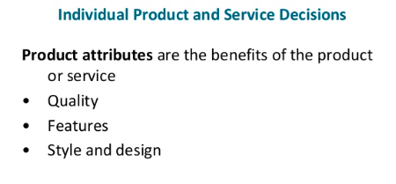

Slide 18
Individual product and service decisions
Product quality is one of the marketer’s major positioning tools, which includes quality level and consistency.
Performance quality: level of quality that supports the product’s positioning
Conformance quality: the product's freedom from defects and consistency in delivering a targeted level of performance.

Slide 19
Style: Describes the appearance of the product.
Design: Contributes to a product’s usefulness as well as to its looks.
Good design begins with a deep understanding of the customer needs. It should concentrate on how customers will use and benefit from the product.

Slide 20
Individual product and service decisions
Brand: the name, term, sign or design- or a combination of these- that identifies the maker or seller of a product or service
Brand equity: differential effect the brand name has on customer response to the product and its marketing

Slide 21
Individual product and service decisions
Packaging:
involves designing and producing the container or wrapper for a product.
Gather attention, describe the product, and make the sale.
Labels identify the product or brand, describe attributes, and provide promotion.

Slide 22
Product Line Decisions
Line Length
Line Width/Breadth
Line Depth
Line Filling
Line Stretching

Slide 23
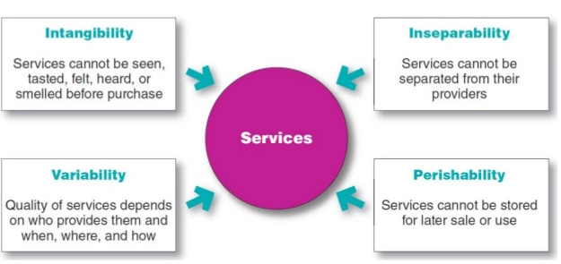
Service Marketing
The Nature and Characteristics of Service:

Slide 24
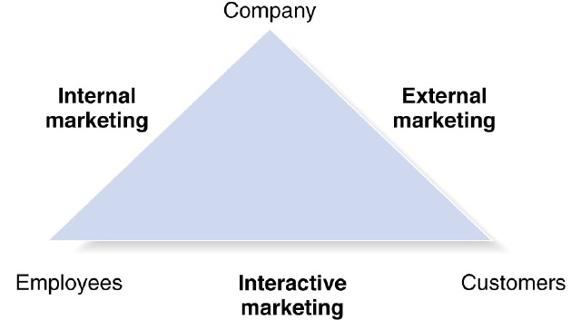
Service Value Chain

Slide 25
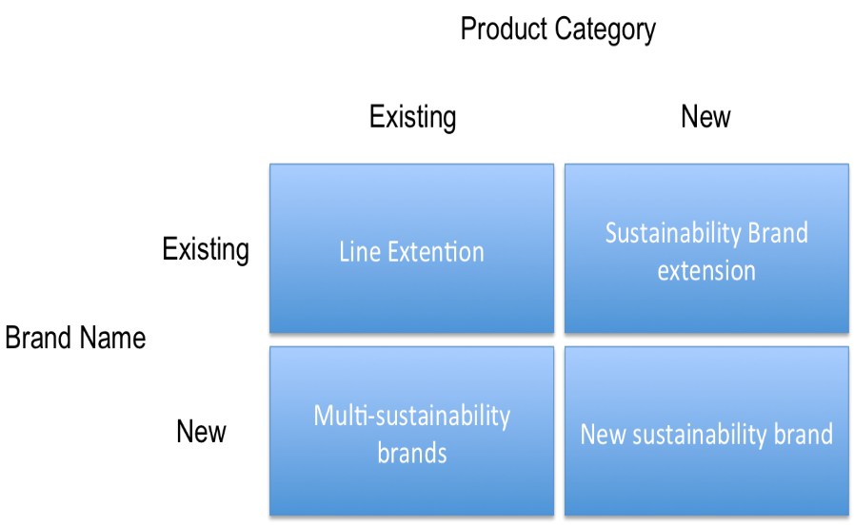
Brand development

Slide 26
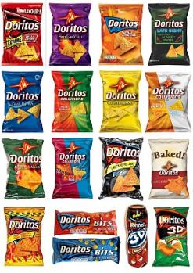
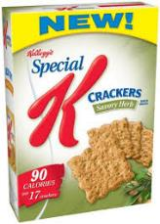
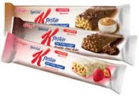
Line extensions: extending an existing brand name to new forms, colors, sizes, ingredients or flavors of an existing product category.
Eg: Doritos providing 22 different flavors
Brand extensions: extending an existing brand name to new product categories.
Eg: Kellogg's introducing full line of cereals plus line of crackers, fruit crisps, nutritional bars, etc

Slide 27
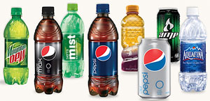
Multi brand: companies marketing different brands in a given product category. Eg; Pepsi co marketing different soft drinks, sports and energy drinks, etc.
New brands: Introducing new brands. Eg: Diversification.

