Slide 1
Chapter 2 Consumer Research

Slide 2
Chapter Outline
Introduction to Quantitative and Qualitative Research
Overview of the Consumer Decision Process
Quantitative Research
Qualitative Research

Slide 3
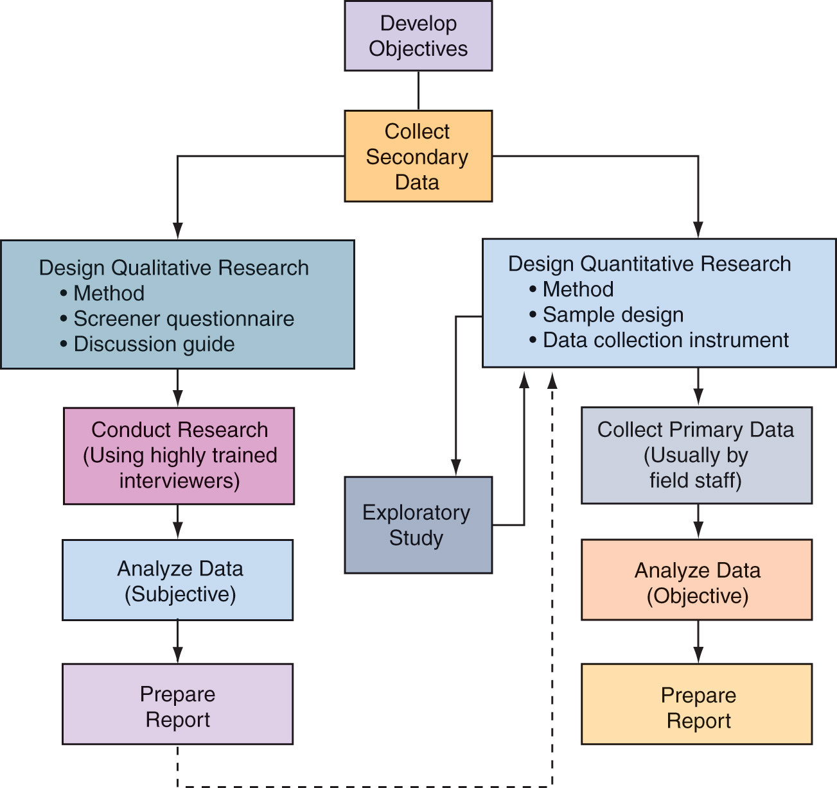
The Consumer Research Process Figure 2.1

Slide 4
Quantitative Research
Descriptive in nature.
Enables marketers to “predict” consumer behavior (positivism).
Research methods include experiments, survey techniques, and observation.
Findings are descriptive, empirical, and can be generalized to larger populations.

Slide 5
Qualitative Research
Consists of depth interviews, focus groups, metaphor analysis, collage research, and projective techniques.
Administered by highly trained interviewer-analysts.
Findings tend to be subjective.
Small sample sizes.

Slide 6
Table 2-1
 | Qualitative Research | Quantitative Research
Study Purpose | Provide insights about ideas Exploratory research before quantitative study | Describe target market Results for strategic marketing decisions
Types of Questions | Open-ended Unstructured | Close-ended Attitude scales
Data Collection Methods | Projective techniques Depth interviews Focus groups | Observation Experimentation Questionnaires

Slide 7
Table 2-1 (continued)
 | Qualitative Research | Quantitative Research
Sampling Methods | Small Nonprobability samples | Large Probability samples
Data Analysis | Analyzed by researchers who collected data Look for “key words” Subjective | Coded, tabulated, and entered into database Use of statistical methods

Slide 8
Developing Research Objectives
Defining purposes and objectives helps ensure an appropriate research design.
A statement of objectives helps to define the type and level of information needed.

Slide 9
Secondary Data
Data that has been collected for reasons other than the specific research project at hand
Includes internal and external data

Slide 10
Types of Secondary Data
Internal Data
Data generated in-house
May include analysis of customer files
Useful for calculating customer lifetime value
External Data
Data collected by an outside organization
Includes federal government, periodicals, newspapers, books, search engines
Commercial data is also available from market research firms

Slide 11
Designing Primary Research
Quantitative Research Designs
Include research design, data collection methods, instruments to be used, and the sample design
Qualitative Research Designs
Include depth interviews, focus groups, projective techniques, and metaphor analysis

Slide 12
Data Collection Methods Observational Research
Helps marketers gain an in-depth understanding of the relationship between people and products by watching them buying and using products
Helps researchers gain a better understanding of what the product symbolizes

Slide 13
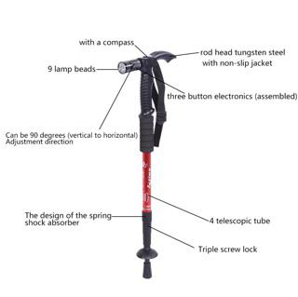
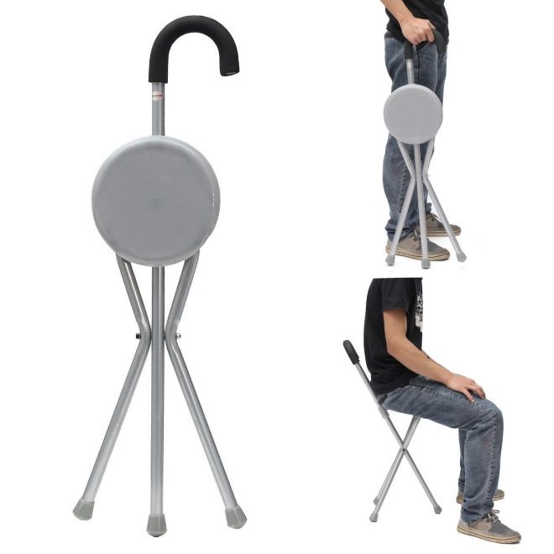
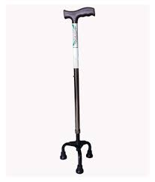
Observational research is often used to design products to meet needs.

Slide 14
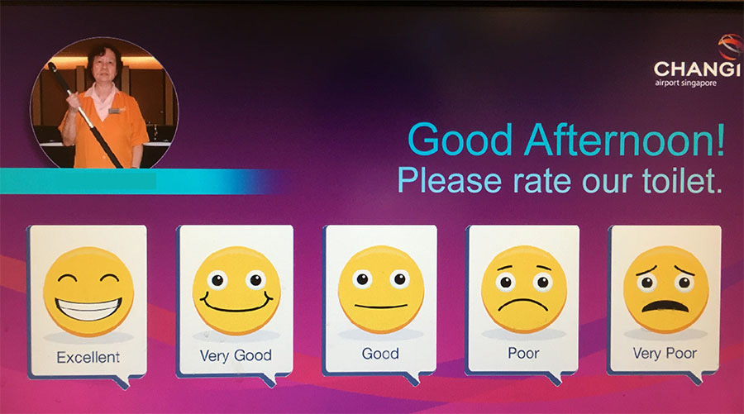
Data Collection Methods Mechanical Observational Research
Uses mechanical or electronic device to record consumer behavior or response
Consumers’ increased use of highly convenient technologies will create more records for marketers
Product audits which monitor sales are heavily used by companies

Slide 15
In line with World Toilet day on 19 November Changi has an interactive easy-to-use touchscreen, located next to the exit of the washroom, which enables users to tap their feedback. This technology-driven initiative, Instant Feedback System (IFS), is capable of sending an immediate alert to the cleaning crew for swift action, if needed!
The IFS works by first asking customers to rate the cleanliness of the washroom on a five-point scale from Excellent to Very Poor. A less than satisfactory rating will then prompt users to indicate the reasons for their rating with a list of eight on-screen icons such as “Wet floor”, “Foul Smell” and “No Toilet Paper”, amongst others. Subsequently, a mobile alert will be transmitted to the cleaning supervisor’s smartphone, who can then initiate immediate action such as cleaning up a wet floor or replenishing toilet paper. With his, users’ feedback is addressed soonest possible and service disruption is minimized.
Apart from the IFS, other washroom features that have been designed to enhance the customer experience include locating the paper towel holders near the sink to make it easier for wet hands to find, and linking the entire soap dispenser under the taps to circumvent the situation where one dispenser runs completely out of soap.

Slide 16
Data Collection Methods Experimentation
Can be used to test the relative sales appeal of many types of variables
An experiment is usually controlled with only some variables manipulated at a time while the others are constant
Can be conducted in laboratories or in the field

Slide 17
Surveys Data Collection Methods
Personal Interview
Mail
Telephone
Online

Slide 18
Validity and Reliability
If a study has validity it collects the appropriate data for the study.
A study has reliability if the same questions, asked of a similar sample, produce the same findings.

Slide 19
Qualitative Collection Method Depth Interview
Usually 30 minutes to 1 hour
Nonstructured
Interpreted by trained researcher
Listen to words as well as “body language”

Slide 20
Qualitative Collection Method Focus Group
8-10 participants
Lasts about 2 hours
Always taped or videotaped to assist analysis
Often held in front of two-way mirrors

Slide 21
Qualitative Collection Method Projective Techniques
Research procedures designed to identify consumers’ subconscious feelings and motivations
Consist of a variety of disguised “tests” incomplete sentence, untitled picture

Slide 22
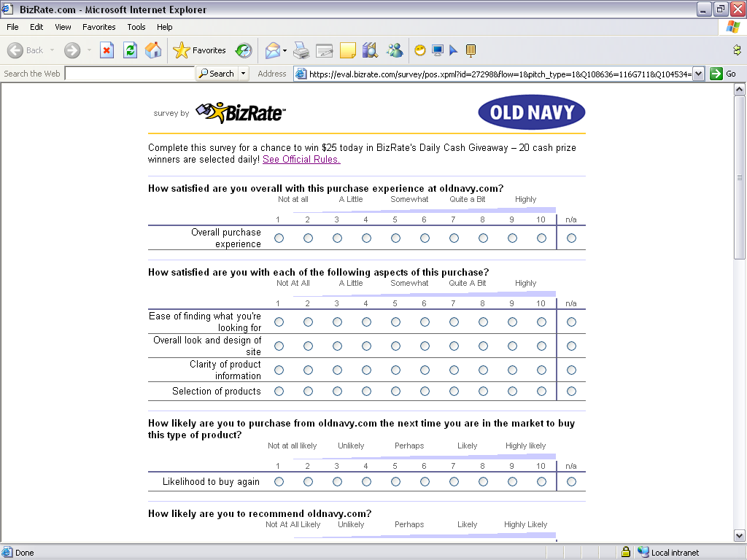
Customer Satisfaction Survey

Slide 23
Sampling and Data Collection
Samples are a subset of the population used to estimate characteristics of the entire population.
A sampling plan addresses:
Whom to survey
How many to survey
How to select them
Researcher must choose probability or nonprobabililty sample.

Slide 24
Table 2.4 Probability Sampling Designs
Simple random sample
Every member of the population has a known and equal chance of being selected.
Systematic random sample
A member of the population is selected at random and then every “nth” person is selected.
Stratified random sample
The population is divided into mutually exclusive groups (such as age groups), and random samples are drawn from each group.
Cluster (area) sample
The population is divided into mutually exclusive groups (such as blocks), and the researcher draws a sample of the groups to interview.

Slide 25
Data Collection Instruments
Likert Scale
Agree strongly , Agree , Neither Agree Nor Disagree , Disagree ,Disagree Strongly
Semantic Differential
Helpful……. Unhelpful
Rank-Order scale
snickers Twix M&Ms

Slide 26
Data Analysis and Reporting Findings
Open-ended questions are coded and quantified.
All responses are tabulated and analyzed.
Final report includes executive summary, body, tables, and graphs.

