Slide 1
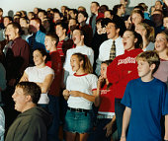
Consumer Motivation Ch. 4

Slide 2
Chapter Outline
Model of the Motivation Process
Goals
Motives
Needs
Motivational Research

Slide 3
Needs and Motivation
Needs are the essence of the marketing concept. Marketers do not create needs but can make consumers aware of needs.
Motivation is the driving force within individuals that impels them to action.

Slide 4
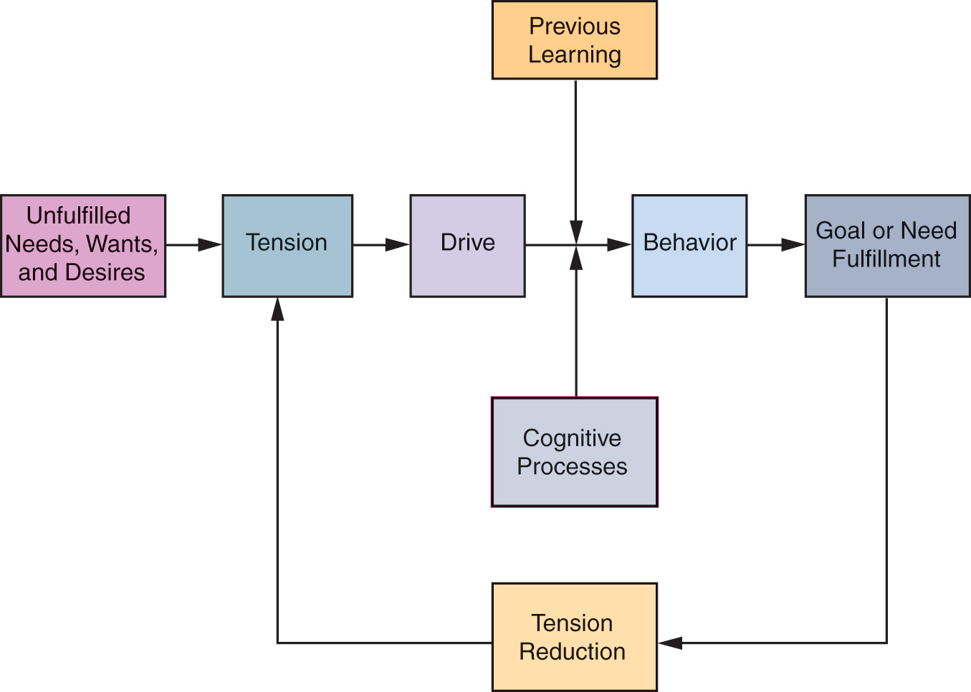
Model of the Motivation Process

Slide 5
Types of Needs
Innate Needs
Physiological (or biogenic) needs that are considered primary needs or motives (food, water, air)
Acquired Needs
Learned in response to our culture or environment. Are generally psychological and considered secondary needs (need for self-esteem, prestige, affection, power, achievement)

Slide 6
Is a body spray an innate or acquired need?

Slide 7
Goals
The sought-after results of motivated behavior
Generic goals are general categories of goals that consumers see as a way to fulfill their needs
Product-specific goals are specifically branded products or services that consumers select as their goals

Slide 8
The Selection of Goals
The goals selected by an individual depend on their:
Personal experiences
Physical capacity
Prevailing cultural norms and values
Goal’s accessibility in the physical and social environment

Slide 9
Discussion Question
What are three generic goals you have set for yourself in the past year?
What are three product-specific goals you have set in the past year?
How were these goals selected? Was it personal experiences, physical capacity, or prevailing cultural norms and values?

Slide 10
Motivations and Goals
Positive
Motivation
A driving force toward some object or condition
Approach Goal
A positive goal toward which behavior is directed
Negative
Motivation
A driving force away from some object or condition
Avoidance Goal
A negative goal from which behavior is directed away

Slide 11
Rational versus Emotional Motives
Rationality implies that consumers select goals based on totally objective criteria such as size, weight, price, or miles per gallon
Emotional motives imply the selection of goals according to personal or subjective criteria

Slide 12
The Dynamic Nature of Motivation
Needs are never fully satisfied
New needs emerge as old needs are satisfied
People who achieve their goals set new and higher goals for themselves

Slide 13
Substitute Goals
Are used when a consumer cannot attain a specific goal he/she anticipates will satisfy a need
The substitute goal will dispel tension
Substitute goals may actually replace the primary goal over time

Slide 14
Frustration
Failure to achieve a goal may result in frustration.
Some adapt; others adopt defense mechanisms to protect their ego.

Slide 15
Defense Mechanism
Methods by which people mentally redefine frustrating situations to protect their self-images and their self-esteem

Slide 16
Defense Mechanisms
Aggression
Rationalization
Regression
Withdrawal
Projection
Identification
Repression

Slide 17
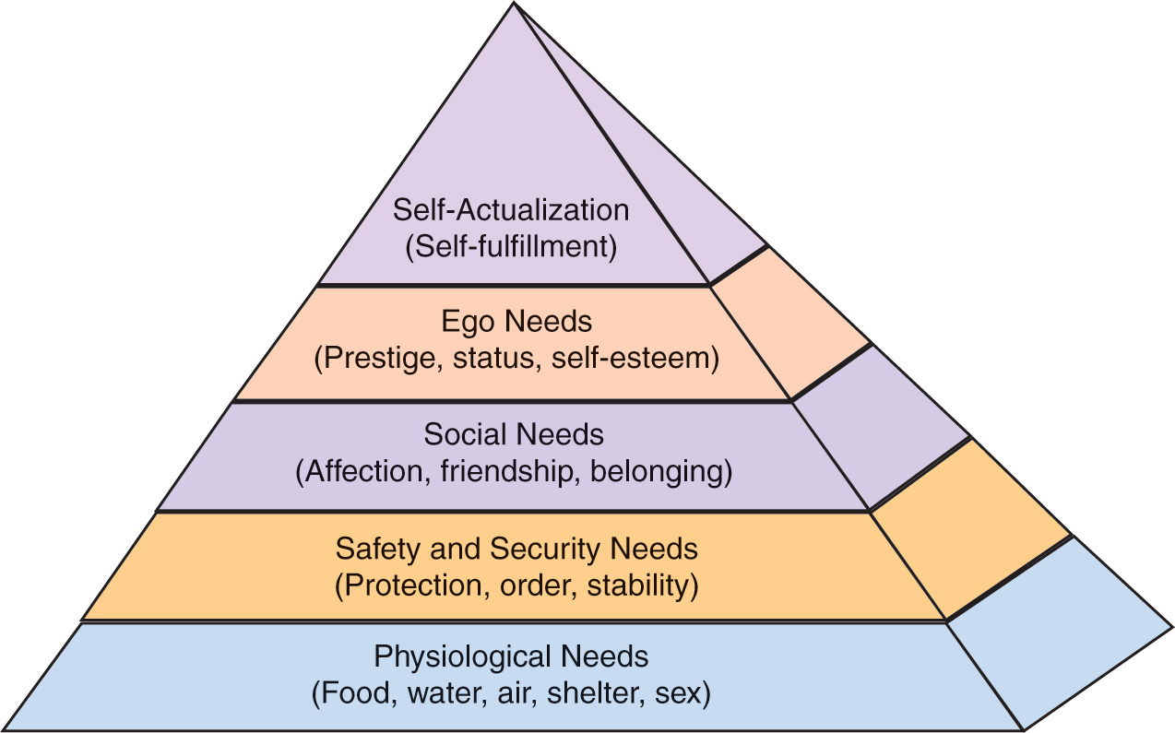
Maslow’s Hierarchy of Needs

Slide 18
Discussion Question
What are three types of products related to more then one level of Maslow’s Hierarchy of Needs.
For each type of product – consider two brands. How do marketers attempt to differentiate their product from the competition?

Slide 19
This ad reflects
a need for
accomplishment
with a
toothpaste.

Slide 20
A Trio of Needs
Power
individual’s desire to control environment
Affiliation
need for friendship, acceptance, and belonging
Achievement
need for personal accomplishment
closely related to egoistic and self-actualization needs

