Slide 1
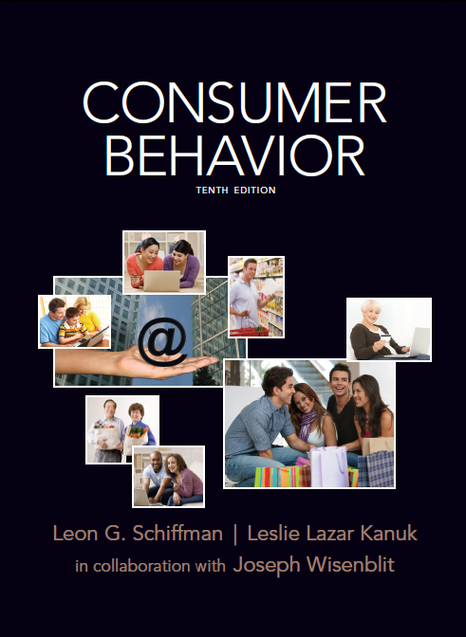
Consumer Attitude Formation and Change

Slide 2
Attitude
A learned tendency to behave in a consistently favorable or unfavorable manner with respect to a given object.
Chapter Eight Slide
Notes:
We have attitudes toward many things – to people, products, advertisements, ideas, and more. For the most part, these attitudes have been learned and guide our behavior toward the object.

Slide 3
What Are Attitudes?
The attitude “object”
The first is that we must clearly define the object which we are measuring.
Is it a product category, a specific brand, or a particular model?
Attitudes are a learned predisposition
The second is the agreement among researchers that attitudes are learned, either through direct experience or from others.
Attitudes have consistency
Attitudes are relatively consistent with the behavior they reflect, they are not necessarily permanent and can change over time.
Attitudes occur within a situation
We all know how our attitude can be affected by a situation – think about the times you have to eat foods that are not necessarily your favorite but they are what is available or what you are being served at a friend’s house.
Chapter Eight Slide
Notes:
It is important to understand these four concepts. The first is that we must clearly define the object which we are discussing or measuring the attitude toward. Is it a product category, a specific brand, or a particular model? The second is the agreement among researchers that attitudes are learned, either through direct experience or from others. Attitudes are consistent, they are not necessarily permanent and can change over time. We all know how our attitude can be affected by a situation – think about the times you have to eat foods that are not necessarily your favorite but they are what is available or what you are being served at a friend’s house.

Slide 4
Structural Models of Attitudes
Tricomponent Attitude Model
Multiattribute Attitude Model
The Trying-to-Consume Model
Attitude-Toward-the-Ad Model
Chapter Eight Slide
Notes:
These are models that attempt to understand the relationships between attitude and behavior. They will be explained in more detail on the following slides.

Slide 5
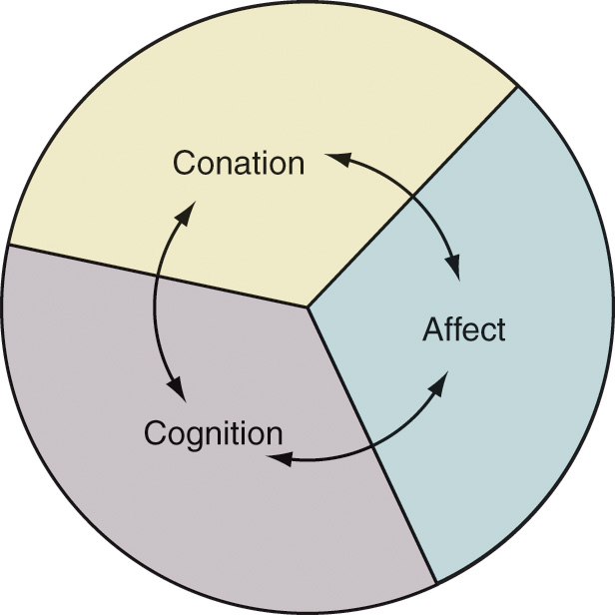
A Simple Representation of the Tricomponent Attitude Model
Cognition
Chapter Eight Slide
Notes:
The tricomponent attitude model has three components, as seen on this figure – the cognitive, affective, and conative components. Each of these will be explained in more detail in the slides that follow.

Slide 6
The Tricomponent Model
COGNITIVE COMPONENT
The knowledge and perceptions that are acquired is what you know or think about an object. This can be formed through direct experience or what you learn from others.
The knowledge you form becomes a belief
AFFECTIVE COMPONENT
How you feel about a brand, the emotions you have toward it, constitutes the affective component of the model.
These feelings often tend to be overall good or bad feelings.
CONATIVE COMPONENT
The conative component describes the likelihood that you will do something in regard to the object.
One of the most important is your intention to buy a certain object.

Slide 7
Multiattribute Attitude Models
Attitude models that examine the composition of consumer attitudes in terms of selected product attributes or beliefs.

Slide 8
Multiattribute Attitude Models
Consumers will like a brand or product that has an adequate level of attributes that the consumer thinks are positive.
For example, if you are buying a home, there is a list of attributes that the home must have – 2 bedrooms, 2 bathrooms, air conditioning, and a back yard. With this model, an attitude is positive for the house that has the most of these attributes.
Types
The attitude-toward-object model
The attitude-toward-behavior model
Theory-of-reasoned-action model
Chapter Eight Slide
Notes:
According to the attitude-toward-object model, consumers will like a brand or product that has an adequate level of attributes that the consumer thinks are positive. For example, if you are buying a home, there is a list of attributes that the home must have – 2 bedrooms, 2 bathrooms, air conditioning, and a back yard. With this model, an attitude is positive for the house that has the most of these attributes.

Slide 9
Positive attitudes toward brands help with brand extensions

Slide 10
Multiattribute Attitude Models
Based on how positive someone's attitude is toward acting a certain way, for instance purchasing a certain brand.
The question is now how likely are you to purchase brand X rather than how highly do you rate brand X.
How you feel about purchasing?
Types
The attitude-toward-object model
The attitude-toward-behavior model
Theory-of-reasoned-action model
Chapter Eight Slide
Notes:
Instead of asking people what product they like and have positive attitudes toward, the attitude-toward-behavior model is based on how positive someone's attitude is toward acting a certain way, for instance purchasing a certain brand. The question is now how likely are you to purchase brand X rather than how highly do you rate brand X.

Slide 11
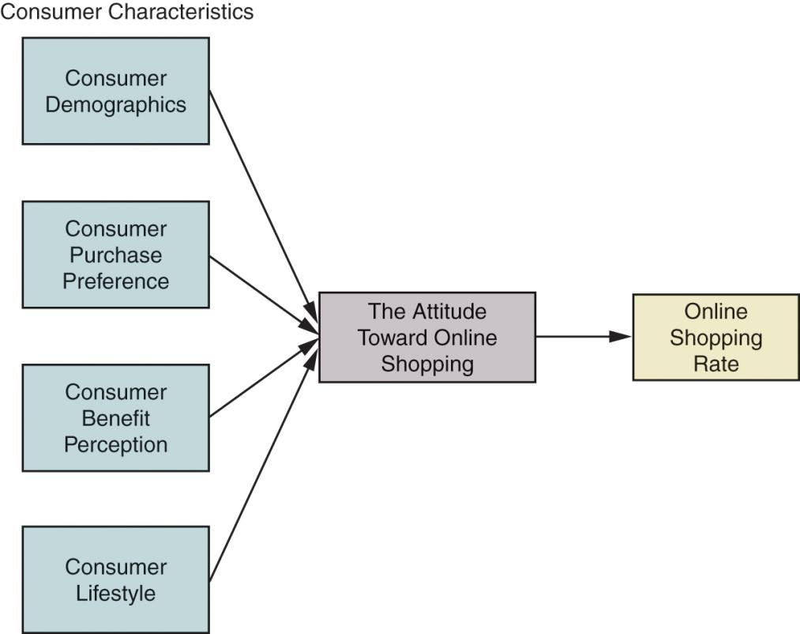
Consumer Characteristics, Attitude, and Online Shopping
Chapter Eight Slide
Notes:
This is a model that looks at people’s attitudes toward purchasing online. On the lefthand side are the consumer characteristics that tend to impact a person’s attitude toward purchasing online. Their attitude was broken down further by how they view nine benefits of online shopping, including effectiveness, convenience, information, safety, service, delivery speed, web design, selection, and familiarity with company name. In addition, the attitude leads to how a consumer will rate an online shopping experience.

Slide 12
Multiattribute Attitude Models
Includes cognitive, affective, and conative components
Includes subjective norms in addition to attitude
How others feel about me purchasing a certain product might influence how I feel about the purchase/behavior
Do I want it or need it?
Types
The attitude-toward-object model
The attitude-toward-behavior model
Theory-of-reasoned-action model
Chapter Eight Slide
Notes:
Like other models, the theory of reasoned action has the three components, cognitive (think), affective (feel), and conative (do). In this model, we also need to understand subjective norms or how a consumer is influenced by others.

Slide 13
A Simplified Version of the Theory of Reasoned Action
Beliefs that the behavior leads to certain outcomes
Evaluation of the outcomes
Beliefs that specific referents think I should or should not perform the behavior
Motivation to comply with the specific referents
Attitude toward the behavior
Subjective norm
Intention
Behavior

Slide 14
Theory of Trying to Consume
An attitude theory designed to account for the many cases where the action or outcome is not certain but instead reflects the consumer’s attempt to consume (or purchase).
To consume something in order to NOT be in the state.
Chapter Eight Slide
Notes:
The theory of trying to consume addresses the fact that many people may want to purchase but in many cases they cannot. This may occur for personal reasons, such as not having enough money, or environmental reasons, such as not being able to go to a particular store.

Slide 15
Selected Examples of Potential Impediments That Might Impact Trying
POTENTIAL PERSONAL IMPEDIMENTS
“I wonder whether my hair will be longer by the time of my wedding.”
“I want to try to lose two inches off my waist by my birthday.”
“I’m going to try to get tickets for the Rolling Stones concert for our anniversary.”
“I’m going to attempt to give up smoking by my birthday.”
“I am going to increase how often I run two miles from three to five times a week.”
“Tonight, I’m not going to have dessert at the restaurant.”
POTENTIAL ENVIRONMENTAL IMPEDIMENTS
“The first 1,000 people at the baseball game will receive a team cap.”
“Sorry, the car you ordered didn’t come in from Japan on the ship that docked yesterday.”
“There are only two cases of chardonnay in our stockroom. You better come in sometime today.”
“I am sorry. We cannot serve you. We are closing the restaurant because of an electrical problem.”
Chapter Eight Slide
Notes:
There are many reasons why people do not consume even if they want to purchase a product. Table 8.7 in the text gives examples of both personal and environment impediments. How many times have these reasons stopped you from purchasing? What can marketers do to remove these impediments?

Slide 16
Attitude-Toward-the-Ad Model
A model that proposes that a consumer forms various feelings (affects) and judgments (cognitions) as the result of exposure to an advertisement, which, in turn, affect the consumer’s attitude toward the ad and attitude toward the brand.
Chapter Eight Slide
Notes:
The attitude-toward-the-ad model helps us understand how advertising impacts attitudes.

Slide 17
Issues in Attitude Formation
How attitudes are learned
Conditioning and experience
Knowledge and beliefs
Sources of influence on attitude formation
Personal experience
Influence of family
Direct marketing and mass media
Personality factors
This is the consumer’s need for cognition. People will form attitudes based on the information that best suits them, information for the high need for cognition consumer, and images and spokespeople for the low need for cognition.
Chapter Eight Slide
Notes:
Attitudes are formed through learning. Recalling the concepts of classical and operant conditioning from earlier chapters, we recall that two stimuli can be paired or linked together to form a learned response. In addition, consumers can learn attitudes from rewards or outcomes from behavior.
If attitudes are learned, then it is through experiences that this learning occurs. This can be from personal experience or from experiences with friends or exposure to marketing influences. Another topic studied in an earlier chapter comes into play with attitude formation. This is the consumer’s need for cognition. People will form attitudes based on the information that best suits them, information for the high need for cognition consumer, and images and spokespeople for the low need for cognition.

Slide 18
Functional Theory of Attitudes
UTILITARIAN
FUNCTION:
Relates to rewards
and punishments
VALUE-EXPRESSIVE FUNCTION:
Expresses consumer’s
values or self-concept
EGO-DEFENSIVE
FUNCTION:
Protect ourselves from external threats
or internal feelings
KNOWLEDGE
FUNCTION:
Need for order, structure,
or meaning
Notes:
Daniel Katz developed the functional theory of attitudes to explain how attitudes facilitate social behavior. This theory suggests that attitudes exist because they serve some function for the person. Two people can have an attitude toward some object for very different reasons.

Slide 20
Changing the Basic Motivational Function
Changing the basic motivational function means to change the basic need that a consumer is trying to fulfill.
Utilitarian function is how the product is useful to us. A marketer might want to create a more positive attitude toward a brand by showing all it can do.
An ego-defensive function would show how the product would make them feel more secure and confident.
A value-expressive function would more positively reflect the consumer’s values, lifestyle, and outlook.
Finally, the knowledge function would satisfy the consumer’s “need to know” and help them understand more about the world around them.
It is important for marketers to realize that they might have to combine functions because different customers are motivated to purchase their products for different reasons.
Someone might buy a product because it tastes good and fills them up (utilitarian), while another thinks it is low fat and will make them healthy and therefore look better (ego-defensive).

Slide 21
Behavior Can Precede or Follow Attitude Formation
Cognitive Dissonance Theory
Attribution Theory
Holds that discomfort or dissonance occurs when a consumer holds conflicting thoughts about a belief or an attitude object.
A theory concerned with how people assign causality to events and form or alter their attitudes as an outcome of assessing their own or other people’s behavior.
Chapter Eight Slide
Notes:
Up to this point, we have always had an attitude change, which led to a behavior. It is now time to consumer a behavior that might change attitude. There are two main theories that address this difference in sequencing. The cognitive dissonance theory occurs after the consumer has done something, let’s say purchase a product or accepted admission to a college. They begin to create an attitude around their behavior which is often based on dissonance or discomfort.
Attribution theory is related to the question we have after a behavior of “Why did I do that?” This process of making inferences about behavior can lead to attitude formation and change.

Slide 22
Attribution Theory
A theory concerned with how people assign casualty to events and form or alter their attitudes as an outcome of assessing their own or other people’s behavior.

Slide 23
Defensive Attribution
A theory that suggests consumers are likely to accept credit for successful outcomes (internal attribution) and to blame other persons or products for failure (external attribution).

