Slide 1
Consumer Perception

Slide 2
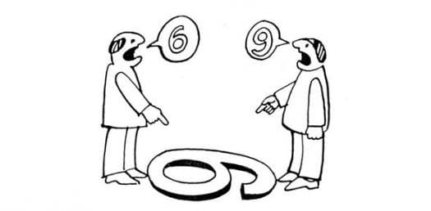

Slide 3
Perception
The process by which an individual selects, organizes, and interprets stimuli into a meaningful and coherent picture of the world
How we see the world around us.
You and your friend might see the same person, thing, or event yet you will interpret in different ways.
Chapter Six Slide
Notes:
Perception is how we see the world around us. You and your friend might see the same person, thing, or event yet you will interpret in different ways. This interpretation is highly individualized and depends on each person’s own needs, values, and expectations.
These are the four major elements of perception. They will be described in detail on the following slides.

Slide 5
Elements of Perception
Sensation
Absolute threshold
Differential threshold
Subliminal perception

Slide 6
Vision
Sensory Systems
Smell
Visual Elements in Advertising,
Store Design and Packaging.
Sound
Odors Can Stir Emotions or Create
Feelings Such as Happiness/ Hunger.
Touch
Research Has Analyzed Effects of : Background Music & Speaking Rates
Taste
Shown to Be a Factor in Sales Interactions.
Ethnicity Affects Taste Preferences.

Slide 8
https://www.theguardian.com/business/2016/jun/01/ms-to-turn-off-music-in-stores-following-customer-feedback

Slide 9
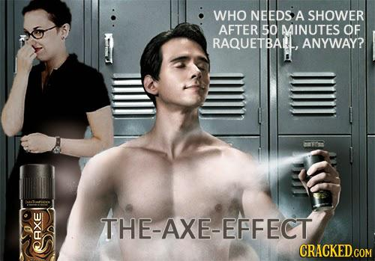

Slide 13
Sensation
The immediate and direct response of the sensory organs to stimuli
A stimulus is any unit of input to any of the senses.
The absolute threshold is the lowest level at which an individual can experience a sensation.

Slide 15
Differential Threshold
Minimal difference that can be detected between two similar stimuli
Also known as the just noticeable difference (the j.n.d.)

Slide 16
Weber’s Law
The j.n.d. between two stimuli is not an absolute amount but an amount relative to the intensity of the first stimulus
Weber’s law states that the stronger the initial stimulus, the greater the additional intensity needed for the second stimulus to be perceived as different.

Slide 17
Weber’s Law
It was a German scientist named Ernst Weber who realized that this difference was not a fixed amount.
The best example is when you buy a low-priced product like a cup of coffee from Starbucks. A $1 increase in your tall coffee would be noticed by you. But if you were buying a laptop whose price changed from $455 to $456 you might not even notice.

Slide 18
Marketing Applications of the J.N.D.
Marketers need to determine the relevant j.n.d. for their products
so that negative changes are not readily discernible to the public
so that product improvements are very apparent to consumers

Slide 19
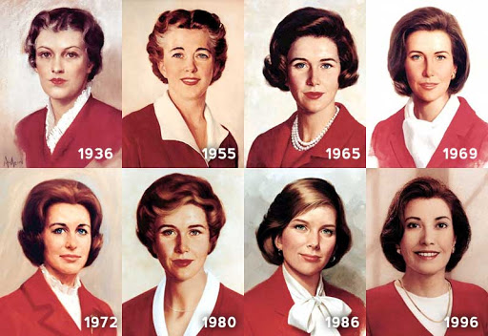

Slide 21
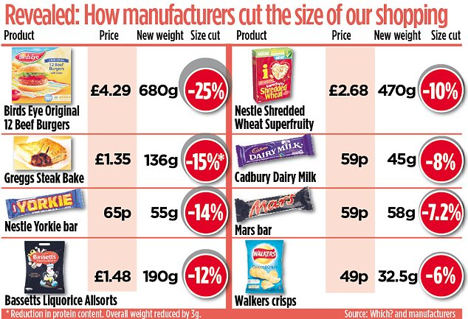

Slide 23
Subliminal Perception
Stimuli that are too weak or too brief to be consciously seen or heard may be strong enough to be perceived by one or more receptor cells.

Slide 24
Is Subliminal Persuasion Effective?
Extensive research has shown no evidence that subliminal advertising can cause behavior changes
Some evidence that subliminal stimuli may influence affective reactions

Slide 27
Aspects of Perception
Selection
Organization
Interpretation
Chapter Six Slide
Notes:
Consumers are bombarded by stimuli and are therefore very selective as to what messages and information they perceive. As new information comes to their mind, it is organized within their mind. Finally, consumers interpret the stimuli based on their needs, expectations, and experience. Each of these stages will be examined on the following slides.

Slide 28
Perceptual Selection
Selection Depends Upon:
Nature of the stimulus
Expectations
Motives
Needs or wants for a product or service.
Includes the product’s physical attributes, package design, brand name, advertising and more…
Based on familiarity, previous experience or expectations.
Why you went to buy?
Did you like it before?
Why did you notice?
Chapter Six Slide
Notes:
Consumers are exposed to thousands, if not millions, of stimuli every day. The stimuli that they perceive depends on the three factors on this slide – nature of the stimulus, expectations, and motives. Think of the last time you went to the supermarket – what products did you notice? Why? Perhaps it was the nature of the stimulus, the packaging of the product. You might notice a sale on your favorite brand because you have positive expectations of how that brand performs. Finally, your motive in going to the supermarket might have been to purchase eggs and milk. This might lead you to notice promotions or point-of-purchase displays for these products.

Slide 29
Nature of stimulus
Physical attributes
Package design
Brand name
Celebrity
Positioning of a print ad

Slide 30
Product Features

Slide 31
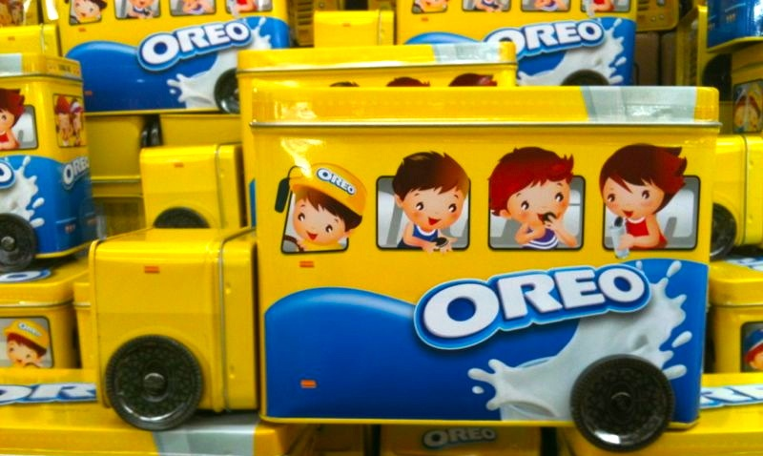
Packaging

Slide 32
Brand Name

Slide 33
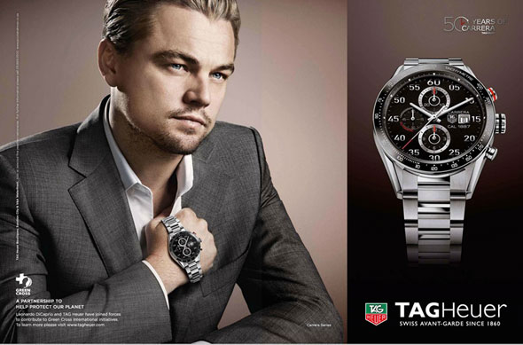
Celebrities

Slide 34
Ad size and position

Slide 35
Expectations
Ideal
Normative
Adequate

Slide 36
Motives
When do I notice
Why do I notice

Slide 37
Perceptual Selection Important Concepts
Selective Exposure
Consumers seek out messages which:
Selective Attention
Heightened awareness when stimuli meet their needs
Perceptual Defense
Subconsciously screening out of stimuli which are psychologically threatening
Are pleasant
They can sympathize
Reassure them of good purchases
Consumers prefer different messages and medium
Perceptual Blocking
Consumers avoid being bombarded by:
Tuning out
TiVo
Actively avoid painful ones
Chapter Six Slide
Notes:
These four concepts are very important to consider when understanding how consumers select which stimuli they will perceive. In general, they are selective as to what they are exposed to – what messages they seek out. Once exposed, they are selective of their attention to some messages over others. Consumers might even screen out or block messages that they consider threatening or overwhelming.

Slide 38
Organization
People tend to organize perceptions into figure-and-ground relationships.
The ground is usually hazy.
Marketers usually design so the figure is the noticed stimuli.
An advertiser wants just enough contrast so that the figure is noticed but that the background adds a sensory effect.
Product placement, when a product appears in a movie or television show, can be considered a figure and ground issue.
Principles
Figure and ground
Grouping
Closure
Chapter Six Slide
Notes:
Organization refers to how people organize stimuli into groups and perceive them as a whole. This is referred to as Gestalt which means pattern in German. There are three major principles of perceptual organization, including figure and ground, grouping, and closure. The first, figure and ground, has to do with contrast. An advertiser wants just enough contrast so that the figure is noticed but that the background adds a sensory effect. Product placement, when a product appears in a movie or television show, can be considered a figure and ground issue. The advertiser wants the product (figure) to be noticed as it blends in with the ground (character in the show). This web link takes you to a very fun site called sporcle. The quiz that is opened for you refers to the top brands, organized by product category. Is this similar to how you organize these brands? How did you do on the test?

Slide 41
Organization
People group stimuli to form a unified impression or concept.
Grouping helps memory and recall.
Objects grouped together are seen as a whole.
Consumers group stimuli together to organize them.
Principles
Figure and ground
Grouping
Closure
Chapter Six Slide
Notes:
Grouping is common in perceptual organization. Whether it is numbers (phone numbers) that are grouped in 3 or 4 digits OR images in an ad, consumers will group stimuli together to organize them. This grouping helps memory and recall.

Slide 43
Organization
Principles
People have a need for closure and organize perceptions to form a complete picture.
Will often fill in missing pieces
Incomplete messages remembered more than complete
Figure and ground
Grouping
Closure
Chapter Six Slide
Notes:
Individuals organize their perceptions to form a complete picture. Our minds have a need for closure and we will work to fill in the missing information when we are presented incomplete stimuli.

Slide 46
Interpretation
People hold meanings related to stimuli.
Perceptual interpretation occurs because consumers have unique motives, interests, and experiences.
How people interpret often reveals a lot about themselves. For instance, individuals tend to have stereotypes due to physical appearances, descriptive terms, first impressions, and the halo effect.
Stereotypes
First Impressions
Halo Effect
Physical Appearances
Descriptive Terms
Stereotypes
First Impressions
Halo Effect
Physical Appearances
Chapter Six Slide
Notes:
Perceptual interpretation occurs because consumers have unique motives, interests, and experiences. How people interpret often reveals a lot about themselves. For instance, individuals tend to have stereotypes due to physical appearances, descriptive terms, first impressions, and the halo effect. These will be examined in the next couple of slides.

Slide 48
Interpretation
Positive attributes of people they know to those who resemble them
Important for model selection
A beautiful spokesperson might be perceived as possessing expertise for beauty products. A certain color to a food might make us think it is healthier.
Stereotypes
First Impressions
Halo Effect
Physical Appearances
Descriptive Terms
Stereotypes
First Impressions
Halo Effect
Physical Appearances
Chapter Six Slide
Notes:
We often make decisions based on how people or products appear. A beautiful spokesperson might be perceived as possessing expertise for beauty products. A certain color to a food might make us think it is healthier. The web link is an example of a tool marketers can use on their website to give a “human” touch. There are many attractive hosts to choose from.

Slide 50
Interpretation
First impressions are lasting
The perceiver is trying to determine which stimuli are relevant, important, or predictive
Stereotypes
First Impressions
Halo Effect
Physical Appearances
Descriptive Terms
Stereotypes
First Impressions
Halo Effect
Physical Appearances
Chapter Six Slide
Notes:
First impressions are lasting so a marketer should be careful how they advertise new products.

Slide 51
Interpretation
Consumers perceive and evaluate multiple objects based on just one dimension.
For instance, a consumer might consider a clean waiting room as an indication of a good dentist.
For this reason, marketers use the halo effect when licensing names of products or choosing spokespeople.
Stereotypes
First Impressions
Halo Effect
Physical Appearances
Descriptive Terms
Stereotypes
First Impressions
Halo Effect
Physical Appearances
Chapter Six Slide
Notes:
With the halo effect, a person uses just one dimension in evaluating a person, product, or service. For instance, a consumer might consider a clean waiting room as an indication of a good dentist. For this reason, marketers use the halo effect when licensing names of products or choosing spokespeople.

Slide 52
Product Positioning
Establishing a specific image for a brand in the consumer’s mind in relation to competing brands
Conveys the product in terms of how it fulfills a need
Successful positioning creates a distinctive, positive brand image
Chapter Six Slide
Notes:
It is important to realize that good position defines the product in a unique place in the consumer’s mind when compared to competing products. This place is the result of the benefits that are offered by the product and how they are different or better than those of the competitor’s products.

Slide 53
Packaging as a Positioning Element
Packaging conveys the image that the brand communicates to the buyer.
Color, weight, image, and shape are all important.
Repositioning might be necessary because:
Increased competition
Changing consumer tastes
Chapter Six Slide
Notes:
A consumer often derives their understanding of a product and its benefits from the packaging. A good example would be shampoo. The shape of the bottle, the choice of colors and symbols, and even the cap can help the consumer position the product and determine if the product’s benefits are gentle, color safe, strong cleaning, or conditioning.
Many marketers will need to reposition their product over time due to either market changes or consumer preference changes. This is often challenging to marketers, especially if their product had been perceived negatively in the marketplace.

Slide 54
Positioning of Services
Image is a key factor for services
Services often want a differentiated positioning strategy to market several versions of their service to different markets.
Chapter Six Slide
Notes:
Positioning of services has extra challenges due to the intangible nature of a service. You cannot hold it in your hand and look at it – you must make your decision based on visual images and tangible cues, such as delivery trucks, storefronts, or other marketing tactics.

Slide 55
Perceived Quality of Services
Difficult due to characteristics of services
Intangible
Variable
Perishable
Simultaneously Produced and Consumed
Chapter Six Slide
Notes:
Services have unique characteristics that make quality a more complex issue. First of all, services are intangible. It is hard for consumers to compare them side by side without having to use external cues. Secondly, they can differ from day to day. We all know that we can get a haircut from a barber or hair stylist on one day that is vastly different from the quality of a previous cut. Services are difficult because they are perishable, they cannot be put on a shelf and left standing from day to day. Finally, the products are consumed and produced at the same time, making quality control hard for the service marketer.
The SERVQUAL scale measures the gap between customer expectations of a service before it is provided versus their perceptions after the service is provided. The scale measures five dimensions, including reliability, responsiveness, assurance, empathy, and tangibility

Slide 56
Price/Quality Relationship
The perception of price as an indicator of product quality (e.g., the higher the price, the higher the perceived quality of the product.)
Chapter Six Slide
Notes:
Value is the trade-off between perceived benefits and perceived sacrifice. As such, a consumer helps understand the benefits many times in terms of the monetary sacrifice. The more they pay, the better product or service they get.

Slide 57
How Consumers Handle Risk
Seek Information
Stay Brand Loyal
Select by Brand Image
Rely on Store Image
Buy the Most Expensive Model
Seek Reassurance
Chapter Six Slide
Notes:
How consumers handle risk will differ by their own individual strategy. That being said, there are a handful of strategies that people tend to use when dealing with risk. The first of these is to seek information so that they have more knowledge when they purchase. Consumers can also stay brand loyal, thereby avoiding risk by sticking with a known product. Consumers can select by brand image to reduce their risk because they may already know and trust the brand, perhaps from buying a different product by the same brand or company. Some consumers will rely on store image to help them reduce risk. Some customers buy the most expensive model assuming that the price/quality relationship will safely deliver them the best product. Finally, consumers seek reassurance through money-back guarantees, warranties, seals of approval and free trials.

