Slide 1
Personality and Consumer Behavior

Slide 2
Personality and The Nature of Personality
The inner psychological characteristics that both determine and reflect how a person responds to his or her environment
http://similarminds.com/personality_tests.html
The Nature of Personality:
Personality reflects individual differences
Personality is consistent and enduring
Personality can change
Chapter Five Slide
Notes:
The study of personality has been approached in many different ways. Heredity, early childhood experiences, and other social influences have a strong effect on who you become. The definition given here is on inner characteristics which distinguish one individual from others. The web link on this page brings you to one of the thousands of personality tests you can find online.

Slide 3
Theories of Personality
Freud’s psychoanalytic theory
Unconscious needs or drives (especially biogenic needs) are at the heart of human motivation
Neo-Freudian personality theory
Social relationships are fundamental to the formation and development of personality
Trait theory
Quantitative approach to personality as a set of psychological traits
Chapter Five Slide
Notes:
These are the three major theories of personalities. There are many more but these three have been chosen because they are important to the relationship between personality and consumer behavior. Each will be discussed in detail on the next couple of slides.

Slide 4
Freudian Theory
Freud proposed that unconscious needs or drives are at the heart of human motivation and personality.
Constructed
This theory states that human personality consists of three interacting systems:
the id,
the superego,
and the ego.

Slide 5
Freudian Theory
The Id
Warehouse of primitive or instinctual needs (physiological needs) for which individual seeks immediate satisfaction or avoiding pain
“Party Animal” of the mind
Operates according to ‘pleasure principle’
Selfish and illogical
Directs energy towards immediate pleasure, rather than thinking about consequences
Chapter Five Slide
Notes:
Sigmund Freud was one of the most important and influential psychiatrists of all time.
Freudian theory itself is based on the existence of unconscious needs or drives as the heart of human motivation and personality. According to Freud, human personality consists of these three systems, the id, super ego and the ego. The Id is the “warehouse” of primitive drives, basic physiological needs such as thirst. The superego drives the individual to fulfill their needs in a socially acceptable function. Finally, the ego is the internal monitor that balances the needs of the id and the superego.

Slide 6
Freudian Theory
The Superego
Individual’s internal expression of society’s moral and ethical codes of conduct
fulfill their needs in a socially acceptable function
Internalizes social rules (what our parents teach)
A kind of “brake” that restraints or inhibits the impulsive forces of the id

Slide 7
Freudian Theory
The Ego
Individual’s conscious control
Functions as an internal monitor that attempts to balance the demands of the id and the sociocultural constraints of the superego
Fights between temptation and virtue
Forces according to reality principle
The conflicts are often internal/subconscious

Slide 8
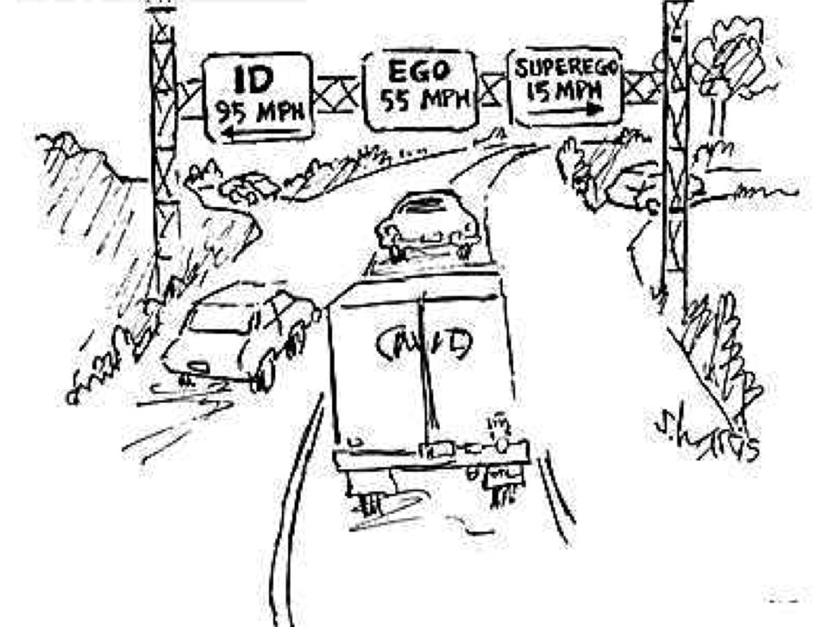

Slide 11
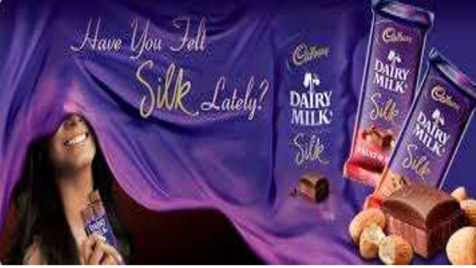
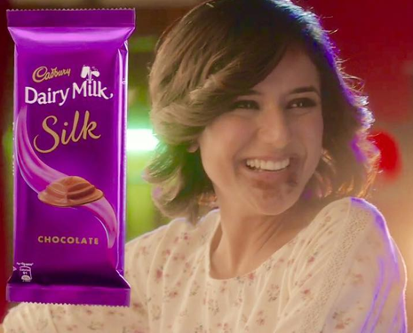
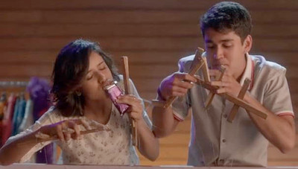

Slide 12
Freudian Theory and “Product Personality”
Consumer researchers using Freud’s personality theory see consumer purchases as a reflection and extension of the consumer’s own personality

Slide 13
Table : Snack Food Personality Traits
Potato Chips:
Ambitious, successful, high achiever, impatient with
less than the best
Tortilla Chips:
Perfectionist, high expectations, punctual, conservational
Pretzels:
Lively, easily bored, flirtatious, intuitive
Snack Crackers:
Rational, logical, contemplative, shy, prefers time alone

Slide 14
Neo-Freudian Theory
Focus on social relationships and their impact on people’s behavior
Factors to reduce feelings of inferiority
Factors to reduce tensions
CAD Theory

Slide 15
CAD Theory
Using the context of child-parent relationships, Karen Horney classified individuals into:
Compliant individuals
Aggressive individuals
Detached individuals

Slide 16
CAD Theory
Compliant Personality
One who desires to be loved, wanted, and appreciated by others.

Slide 17
CAD Theory
Aggressive Personality
One who moves against others (e.g., competes with others, desires to excel and win admiration).

Slide 18
CAD Theory
Detached Personality
One who moves away from others (e.g., who desires independence, self-sufficiency, and freedom from obligations).

Slide 19
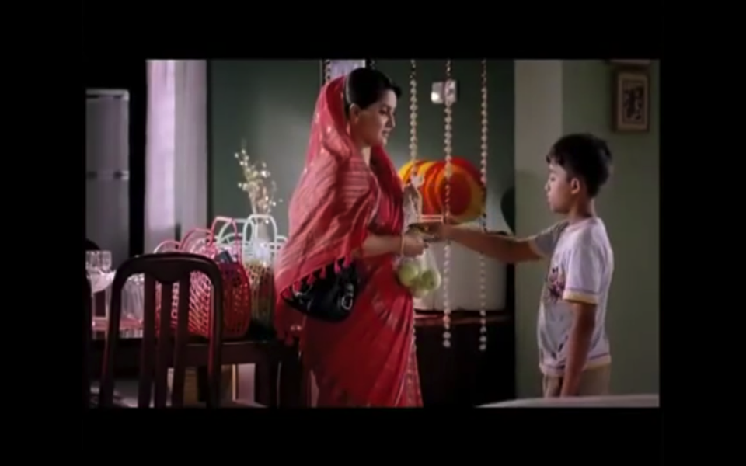
ROBI TVC

Slide 20
Shine Strong Pantene 2014

Slide 21
Hush Puppies

Slide 22
Trait Theory
Personality theory with a focus on psychological characteristics
Focus on measurement of personality in terms of traits
Trait - any distinguishing, relatively enduring way in which one individual differs from another
Personality is linked to broad product categories and NOT specific brands
Chapter Five Slide
Notes:
Unlike Freudian and Neo-Freudian theories, trait theory is less qualitative and more focused on measurement of personality. Tests can be done to measure single traits in consumers such as how receptive they are to new experiences (innovativeness), their attachment to worldly possessions (materialism), and their likelihood to accept or reject foreign-made products (ethnocentrism).

Slide 23
Personality Traits and Consumer Innovators
Consumer innovativeness
Dogmatism
Social character
Need for uniqueness
Optimum stimulation level
Sensation seeking
Variety-novelty seeking
Chapter Five Slide
Notes:
Marketers are very interested in the link between personality and consumer behavior. These are seven topics which are examined on the following slides.

Slide 24
Personality Traits and Consumer Innovators
Consumer Innovativeness
The degree to which consumers are receptive to new products, new services or new practices.

Slide 25
Personality Traits and Consumer Innovators
Dogmatism
A personality trait that reflects the degree of rigidity a person displays toward the unfamiliar and toward information that is contrary to his or her own established beliefs.

Slide 26
Dogmatism
Consumers low in dogmatism (open-minded) are more likely to prefer innovative products to established or traditional alternatives
Highly dogmatic consumers tend to be more receptive to ads for new products or services that contain an appeal from an authoritative figure

Slide 27
Ad Encouraging New Product Acceptance

Slide 28
Social Character
Inner-Directed
Consumers who tend to rely on their own inner values
More likely to be innovators
Tend to prefer ads that stress product features and benefits
Other-Directed
Consumers who tend to look to others for direction
Less likely to be innovators
Tend to prefer ads that feature social acceptance

Slide 29
Need for
Uniqueness
Consumers who avoid
appearing to
conform to
expectations or
standards of others.

Slide 30
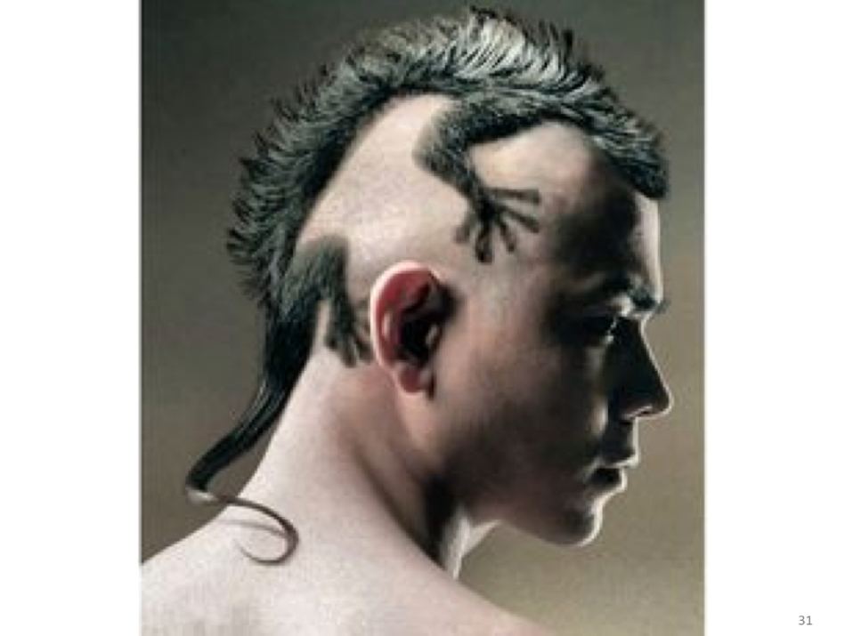

Slide 31
Optimum Stimulation Levels (OSL)
A personality trait that measures the level or amount of novelty or complexity that individuals seek in their personal experiences. High OSL consumers tend to accept risky and novel products more readily than low OSL consumers.

Slide 32
Sensation
Seeking (SS)
A personality trait that is related to the OSL in that it is characterized by the need for varied, novel, and complex sensations and experience, and the willingness to take physical and social risks for the sake of such experience.

Slide 34
Variety-Novelty Seeking
A personality trait similar to OSL, which measures a consumer’s degree to variety seeking

Slide 35
Cognitive Personality Factors
Need for cognition (NFC)
A person’s craving for enjoyment of thinking
Consumers high in NC are more likely to respond to ads rich in product-related information
Consumers low in NC are more likely to be attracted to background or peripheral aspects of an ad
Visualizers versus Verbalizers
A person’s preference for information presented visually or verbally
Chapter Five Slide
Notes:
Researchers are aware that cognitive personality factors influence consumer behavior. In fact, it has been realized that the level of a consumer’s need for cognition affects how they are likely to respond to certain types of advertisements. Those that are high in need for cognition tend to respond to ads that supply product information as opposed to those who are low in need for cognition who tend to be attracted to the background of the ad, attractive models, and cartoon characters.

Slide 36
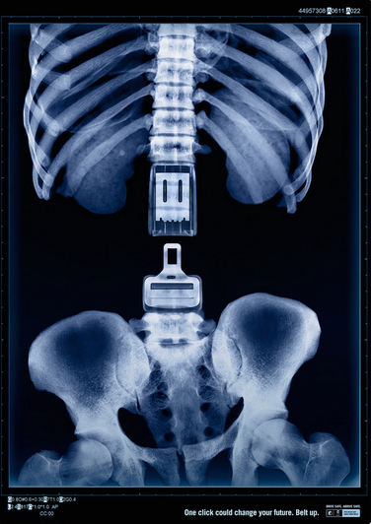
Is This Ad More Appealing to Visualizers or Verbalizers?
Chapter Five Slide

Slide 37
Is This Ad More Appealing to Visualizers or Verbalizers?
Chapter Five Slide

Slide 38
From Consumer Materialism to Compulsive Consumption
Consumer materialism
The degree of the consumer’s attachment to worldly possessions
Materialistic People
Acquire and show off possessions
Self centered and selfish
Seek lifestyle full of possessions
Do not get greater personal satisfaction from possessions

Slide 39
From Consumer Materialism to Compulsive Consumption
Fixated consumption behavior
Consumers fixated on certain products or categories of products
Characteristics
Passionate interest in a product category
Willingness to go to great lengths to secure objects
Dedication of time and money to collecting
Chapter Five Slide
Notes:
Consumer researchers are interested in possession traits and their relationship to consumption. Fixated consumption behavior is displayed by a consumer who seems “fixated” in consuming in a certain product category. For instance, people who collect Star Trek memorabilia from the original television series or comic books would display fixated consumption behavior.
Compulsive consumption behavior begins to enter the area of abnormal behavior. These individuals are somewhat out of control with their purchasing and suffer from a shopping addiction called oniomania.

Slide 40
Compulsive Consumption
Behavior
Consumers who are compulsive buyers have an addiction; in some respects, they are out of control and their actions may have damaging consequences to them and to those around them.
Examples: Uncontrollable shopping, gambling, drug addiction, alcoholism, various food and eating disorders

Slide 41
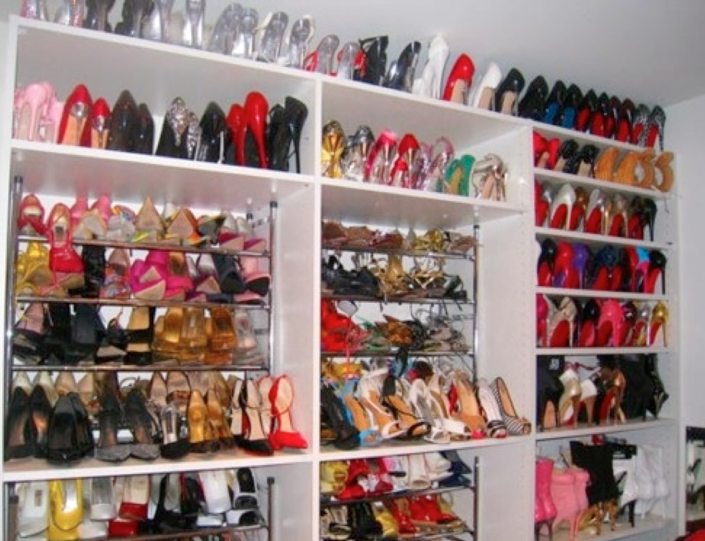

Slide 42
Consumer Ethnocentrism
The consumer’s likelihood to accept or reject foreign-made products
Ethnocentric consumers feel it is wrong to purchase foreign-made products because of the impact on the economy
They can be targeted by stressing nationalistic themes
Chapter Five Slide
Notes:
Consumer ethnocentrism has been found to differ from country to country and to change over time. Certain events in the U.S., including the terrorist attacks on 9/11, will change the ethnocentrism in the country. For some products, the country-of-origin can be very important when marketing the product, but in other situations it must be downplayed. In general, if the image of the country is positive, for example a French wine, it would be advantageous for the marketer to emphasize where the product was made. In many ways, cosmopolitanism is the opposite of ethnocentrism. There is an increase in Australia, for example, due to the multiculturalism.

Slide 44
Brand Personality
Personality-like traits associated with brands
Examples
Volvo - safety
Nike - the athlete
BMW – performance
Brand personality which is strong and favorable will strengthen a brand but not necessarily demand a price premium
Chapter Five Slide
Notes:
Brand personality can be tied to many a successful brand. If the personality is favorable and strong, it will strengthen the brand and lead to a more favorable attitude, brand preference, higher purchase intention, and brand loyalty. In addition, in commodity category, detergent for example, it can help differentiate a brand (it’s the one with the Snuggly Teddy Bear).

Slide 45
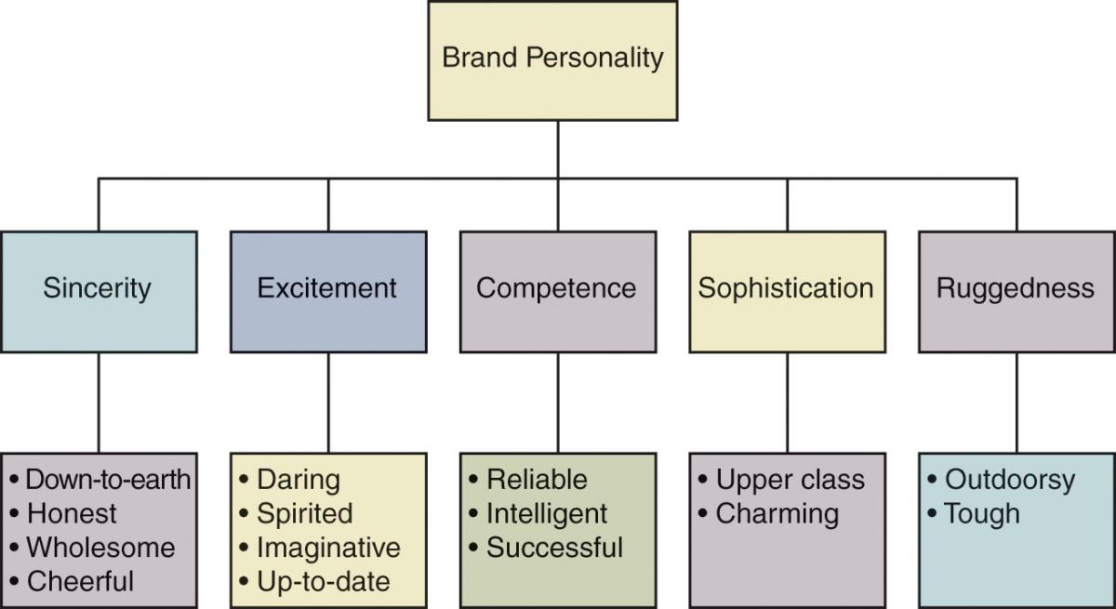
A Brand Personality Framework
This is a brand personality framework that shows the five dimensions of a brands personality.
15 faces of personality
Chapter Five Slide

Slide 47
The Personality-like Associations of Selected Colors
RED
Human, exciting, hot, passionate, strong
Makes food “smell” better
Coffee in a red can be perceived as “rich”
Women have a preference for bluish red
Men have a preference for yellowish red
Coca-Cola “owns” red
ORANGE
Powerful, affordable, informal
Draws attention quickly
BROWN
Informal and relaxed, masculine, nature
Coffee in a dark-brown can was “too strong”
Men seek products packaged in brown
WHITE
Goodness, purity, chastity, cleanliness, delicacy, refinement, formality
Suggests reduced calories
Pure and wholesome food
Clean, bath products, feminine
BLACK
Sophistication, power, authority, mystery
Powerful clothing
High-tech electronics
SILVER, GOLD
Regal, wealthy, stately
Suggests premium price

Slide 48
The Personality-like Associations of Selected Colors
BLUE
Commands respect, authority
America’s favored color
IBM holds the title to blue
Associated with club soda
Men seek products packaged in blue
Houses painted blue are avoided
Low-calorie, skim milk
Coffee in a blue can be perceived as “mild”
YELLOW
Caution, novelty, temporary, warmth
Eyes register it faster
Coffee in yellow can be perceived as “weak”
Stops traffic
Sells a house
GREEN
Secure, natural, relaxed or easy going, living things
Good work environment
Associated with vegetables and chewing gum
Canada Dry ginger ale sales increased when it changed sugar-free package from red to green and white

Slide 49
Different Self-Images
Actual Self-Image
Ideal Self-Image
Social Self-Image
Expected
Self-Image
How consumers see themselves
How consumer would like to see themselves
Ideal Social
Self-Image
How consumers feel others see them
How consumers would like others to see them
How consumers expect to see themselves in the future
Ought-to self
Traits an individual believes are in her duty to possess
Chapter Five Slide
Notes:
There are different self-images that have been recognized in consumer behavior. They all deal with the actual image of an individual and the ideal or expected image of that same person. Many consumers will purchase products to meet the gap between their actual and ideal selves.

