Slide 1
Term paper
Spring 2020

Slide 2
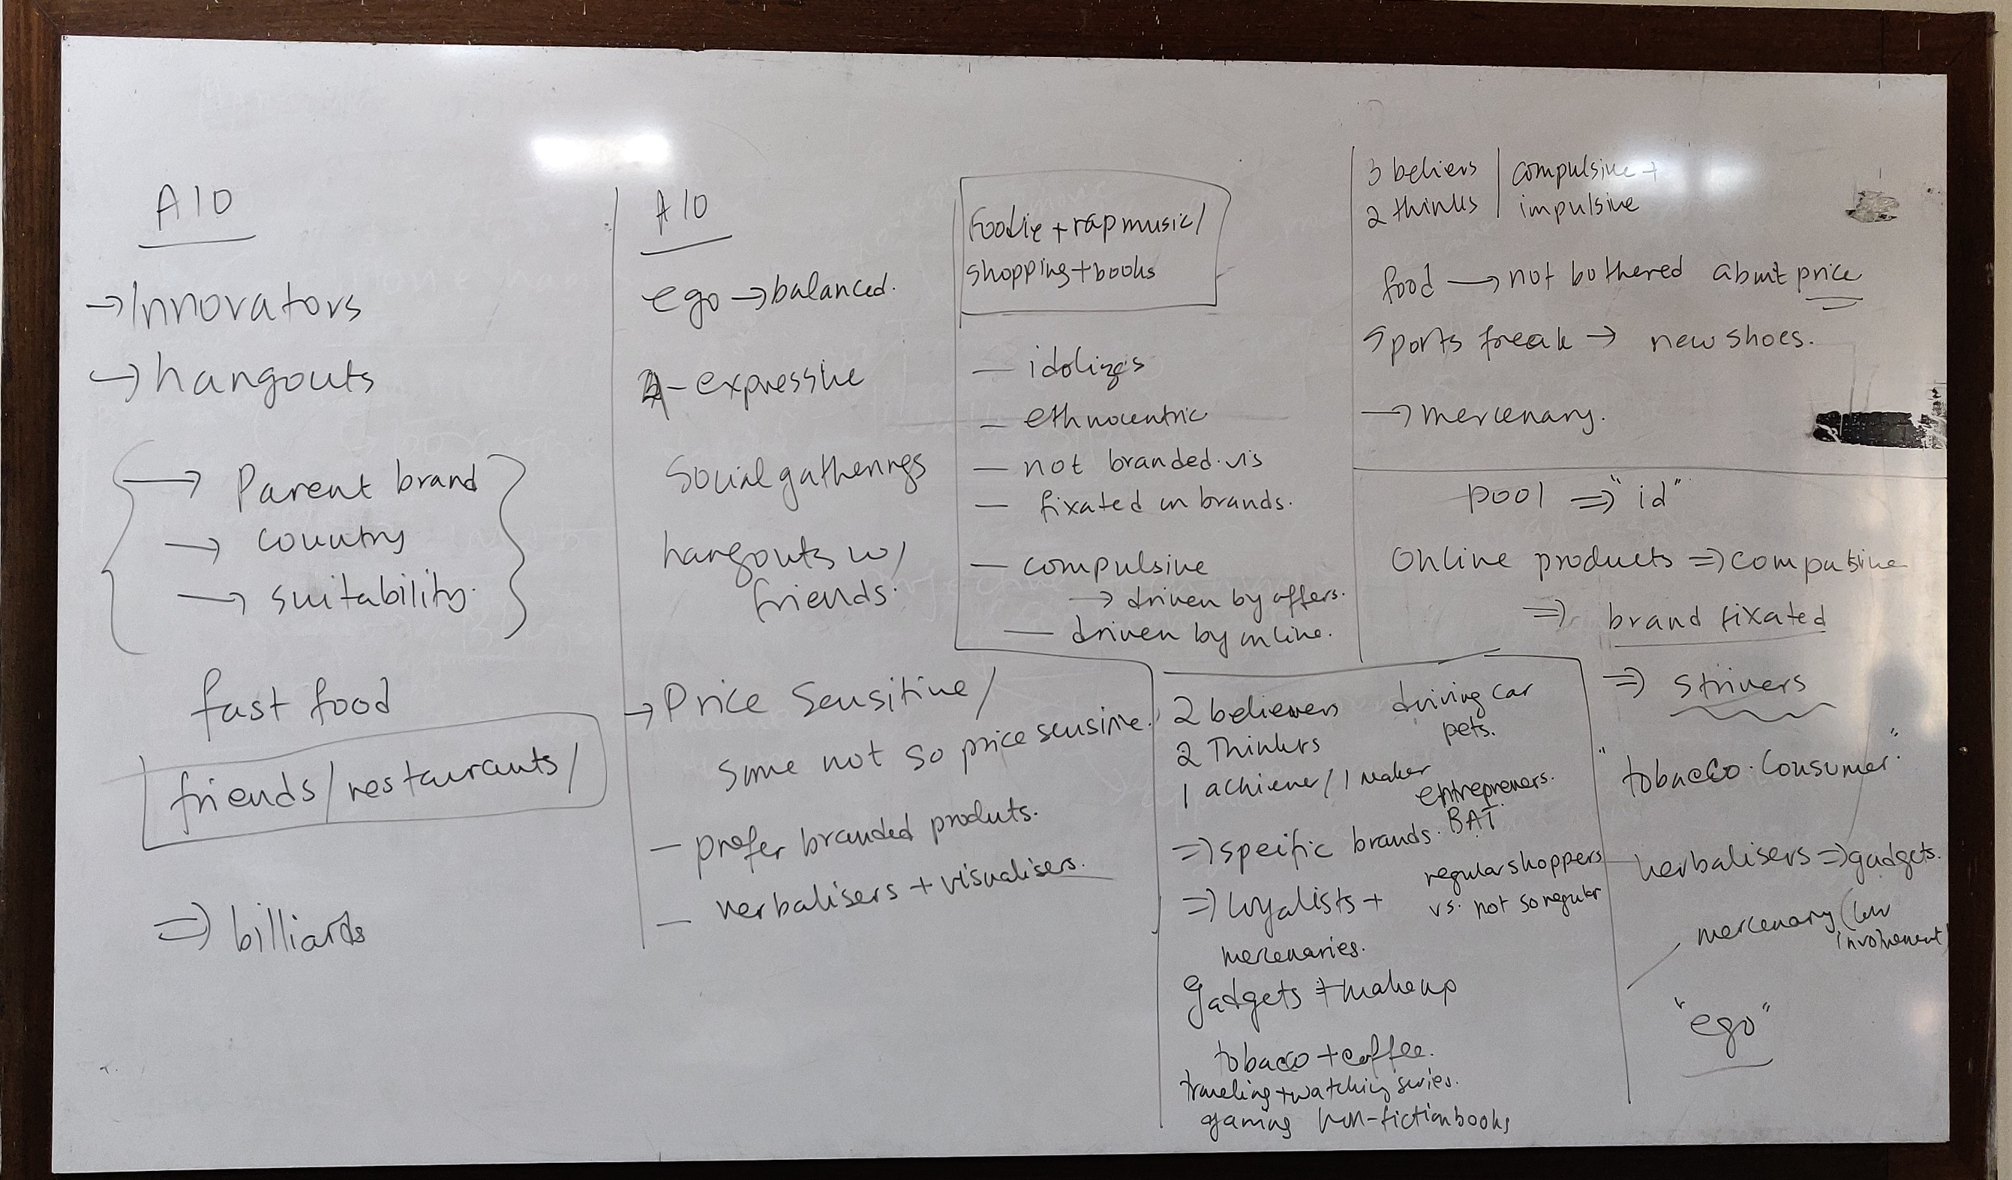

Slide 3
Topic
Businesses are moving towards the societal marketing concept.
Given the AIOs of the class, you are asked to come up with a business plan for the youth.
The objective would be to satisfy their needs and also benefit the society.

Slide 4
Contents expected to be covered in the report
What is the problem you are trying to solve?
Introduce the Product/Service
Introduce the Target Market
Research findings
  Secondary source
  Primary source
What are the strategies and action plans?
  4 Ps Strategies
  Communication action Plans
  1 Demonstration of communication (Print/digital/TVC)

