Slide 1
Marketing: Creating and Capturing Customer Value
CHAPTER 1

Slide 2
Objectives
Introducing Marketing
The Marketing Process
The Marketplace and it’s 5 core concepts
Customer Driven Marketing Strategy
Marketing Management Orientations
Customer Relationship Management
Conclusion

Slide 3
Marketing Defined
“The process by which companies create value for customers and build strong customer relationships in order to capture value from customers in return” (Kotler and Armstrong, 2016)
Two Goals of Marketing
Attract new customers by promising superior value
To keep and grow current customers by delivering satisfaction
Notes:
1867: Billboards/posters
1922: Radio advertising begins
1954: TV ads
1970: Telemarketing
1972: Magazines
1995: the Dot.com Bubble
1998: Blogging emerge
2003: Social Media Begins
2011 till Now: Smartphones and the impact of Social Media

Slide 4
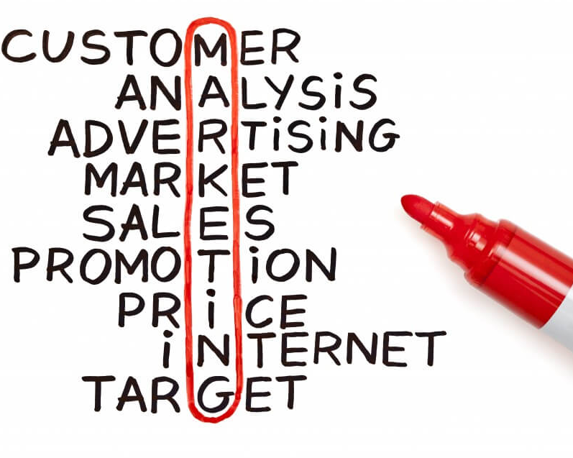

Slide 5
The marketing Process
Understand marketplace and customers’ needs and wants
Design customer value driving marketing strategy
Construct integrated marketing program that delivers superior value
Build profitable relationship and create customer delight
Capture value from customers to create profits and customer equity
Create Value for customers and build customer relationships
Capture value from customers in return
Fig : The Marketing Process: Creating and Capturing Customer Value

Slide 6
marketplace and customer needs
Needs, wants and demands
Exchange and relationships
Market Offerings
Markets
Value and Satisfaction

Slide 7
Marketplace and customer needs
Market offerings: Combination of product, services, information, experiences, persons, places, organizations, information and ideas
Value: Customer’s evaluation of the difference between all the benefit and all the cost of a marketing offering, relative to those of competitors.
Satisfaction: Extent to which a product's perceived performance matches a buyer’s expectation.
Exchange: The act of obtaining a desired object from someone, by offering something in return. Marketers want to grow desirable exchange relationships.
Markets: Set of actual and potential buyers of a products.

Slide 8
Marketplace and customer needs customer NEEDS, WANTS AND DEMANDS
Needs: State of felt deprivation. Eg: Feeling hungry
Wants: Needs shaped by individual personality and culture. Eg: Want to have a fruit tart
Demands: Wants backed by buying power. Eg: Want to have a fruit tart from the Westin
Notes:
– state of felt deprivation.
Wants- needs shaped by individual personality and culture
Demands- wants backed by buying power

Slide 9
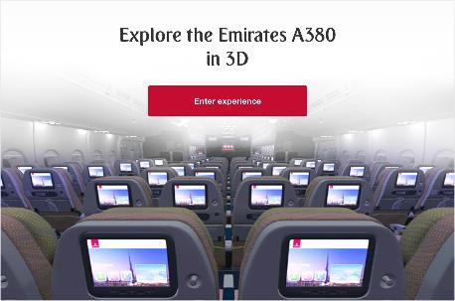

Slide 10
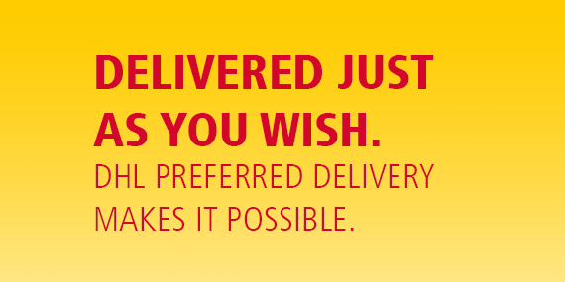

Slide 11
Understanding the Marketplace and customer needs
Marketing offers:
Products
Services
Events
Experiences
Persons
Places
Ideas
Organizations

Slide 12
MARKETING MANAGEMENT ORIENTATIONS
Marketing Orientations
1. Consumers will favor products that are available and highly affordable.
Production
Product
Selling
Marketing
Societal marketing
5. Consider company’s requirements, consumers’ wants and long run interests, and society’s long run interests.
2. Consumers will favor products that offer most in quality, performance and innovative features.
4. Know the needs and wants of target markets and deliver the desired satisfactions better than competitors.
3. Large scale selling and promotion effort is needed

Slide 13
Selling Concept & Marketing Concept

Slide 14
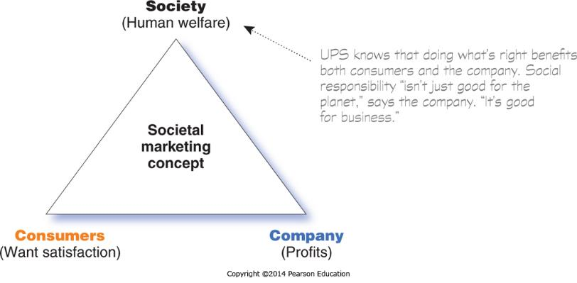
Societal Marketing Concept

Slide 15
Marketing Myopia

Slide 16
Customer Relationship Management
-The overall process of maintaining profitable customer relationships by delivering superior customer value and satisfaction.
Relationship levels:
Full partnerships. Eg: Marie clarie working with Bata
Frequency marketing programs. Eg: loyalty stamp card
Club marketing programs. Eg: Apple local user groups

Slide 17
Customer Equity/Types of Customers
Butterflies
(potentially profitable but not loyal)
True Friends
(both profitable and loyal)
High
Potential profitability
Strangers
(low potential
profitability and little projected loyalty)
Barnacles
(highly loyal and
not very profitable)
Low
Short term
Long term
Projected loyalty
Fig: Customer Relationship Group
Notes:
https://www.youtube.com/watch?v=2X8Bd3-G6IU

Slide 18
The New Marketing Landscape
Globalization
Growth of Non Profit Marketing
The Digital Landscape
Call for Ethics and Social Responsibility

Slide 19
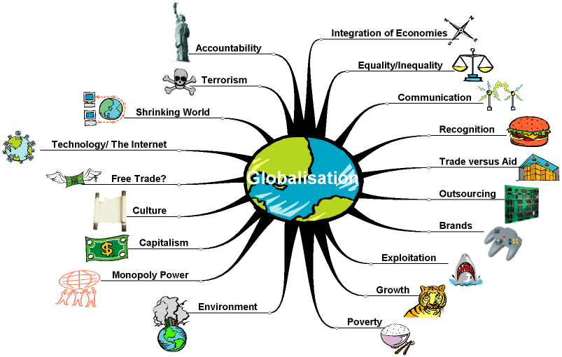

Slide 21
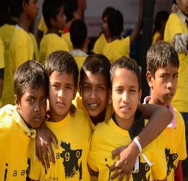
Nonprofit Marketing

