Slide 1
CHAPTER 10
Pricing Strategies

Slide 3
What Is a Price?
The amount of money charged for a product or service.
The sum of all the values that consumers give up in order to gain the benefits of having or using a product or service.
The only element in the marketing mix that produces revenue; all other elements represent costs

Slide 4
Factors to Consider When Setting Prices
Customer Perceptions of Value
Understanding how much value consumers place on the benefits they receive from the product and setting a price that captures that value
Value-based pricing
Good-value pricing
Value-added pricing

Slide 5
Factors to Consider When Setting Prices
Customer Perceptions of Value
Value-based pricing:
Uses the buyers’ perceptions of value, not the sellers cost, as the key to pricing.
Price is considered before the marketing program is set.
Value-based pricing is customer driven

Slide 6
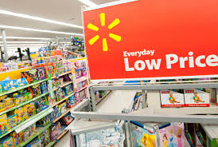
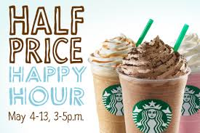
Factors to Consider When Setting Prices
Customer Perceptions of Value
Everyday low pricing (EDLP) involves charging a constant everyday low price with few or no temporary price discounts
High-low pricing involves charging higher prices on an everyday basis but running frequent promotions to lower prices temporarily on selected items

Slide 7
Factors to Consider When Setting Prices
Company and Product Costs
Cost-based pricing
Involves setting prices based on the costs for producing, distributing, and selling the product plus a fair rate of return for its effort and risk
Adds a standard markup to the cost of the product
Cost-based pricing is product driven

Slide 8
Factors to Consider When Setting Prices
Customer Perceptions of Value
Value-based pricing:
Uses the buyers’ perceptions of value, not the sellers cost, as the key to pricing.
Price is considered before the marketing program is set.
Value-based pricing is customer driven

Slide 9
Factors to Consider When Setting Prices
Customer Perceptions of Value
Good-value pricing
Offers the right combination of quality and good service to fair price
Existing brands are being redesigned to offer more quality for a given price or the same quality for less price

Slide 10
Factors to Consider When Setting Prices
Company and Product Costs
Types of costs
Fixed costs
Variable costs
Total costs

Slide 11
Factors to Consider When Setting Prices
Company and Product Costs
Fixed costs are the costs that do not vary with production or sales level
Rent
Heat
Interest
Executive salaries

Slide 12
Factors to Consider When Setting Prices
Company and Product Costs
Variable costs are the costs that vary with the level of production
Packaging
Raw materials

Slide 13
CHAPTER 11

Slide 15
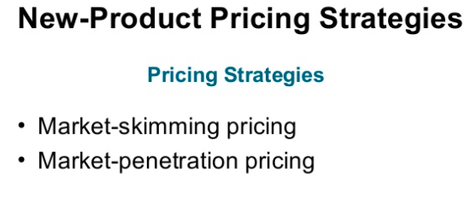

Slide 16
New product pricing strategies
Market Skimming Pricing:
- Strategy with high initial prices, to “skim” revenue layers from the market.
Conditions:
Product quality and image must support the price
Buyers must want the product at the price
Costs of producing the product in small volume shouldn't cancel the advantage of charging more.
Competitors shouldn’t be able to enter the market easily.

Slide 17
New product pricing strategies
Market Penetration:
- Sets a low initial price in order to penetrate the market quickly and deeply to attract a large number of buyers quickly to gain market share.
Conditions:
Price sensitive market
production and distribution costs must decrease as sales volume increases.
Low prices must keep competition out of the market.

Slide 18
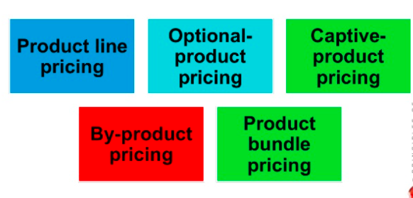
Product Mix Pricing Strategies

Slide 19
Product Mix Pricing Strategies
Product line pricing:
- Takes into account the cost differences between products in line, customer evaluation of their features, and competitors’ prices.

Slide 20
Product bundle pricing:
- Combines several products at a reduced price.

Slide 21
Product Mix Pricing Strategies
Optional product pricing
-takes into account optional or accessory products along with the main product.

Slide 22
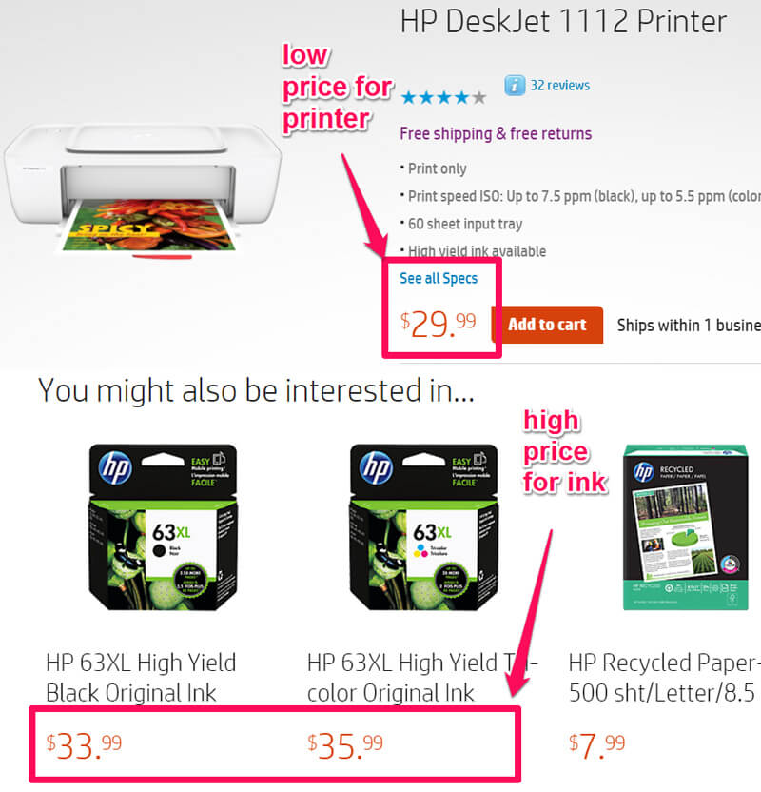
Captive product pricing
- Involves products that must be used along with the main product.

Slide 23
By- product pricing
- Refers to products with little or no value produced as a result of the main product. Producers will seek little or no profit other than the cost to cover storage and delivery.

Slide 24
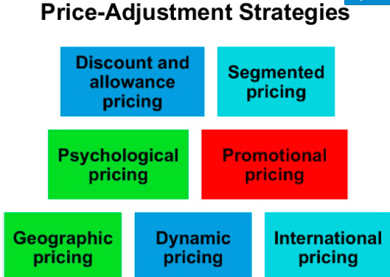

Slide 25
Price Adjustment Strategies
Discount and allowance pricing: Reduces prices to reward customer responses such as paying early or promoting the product.
Segmented pricing: Used when a company sells a product at two or more prices though the difference isn't based on cost.
Market must be segmental
Segments must show different degrees of demand
Watching the market can’t exceed the extra revenue obtained from the price difference
Must be legal

Slide 26
Price Adjustment Strategies
Psychological pricing: Occurs when sellers consider the psychology of prices, not simply economies

Slide 27
Price Adjustment Strategies
Promotional pricing: when prices are temporarily priced below list price or cost to increase demand
Discounts
Special event pricing
Cash rebates
Loss leaders
Low-interest financing, longer warrantees, and free maintenance lower the consumer’s “price.”

Slide 28
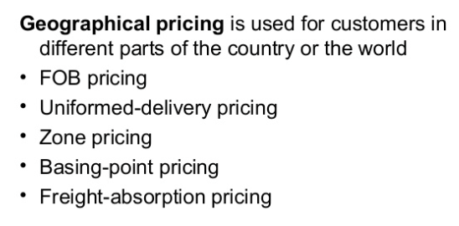
Price Adjustment Strategies

Slide 29
Price Adjustment Strategies
Dynamic pricing is when prices are adjusted continually to meet the characteristics and needs of the individual customer and situations

Slide 30
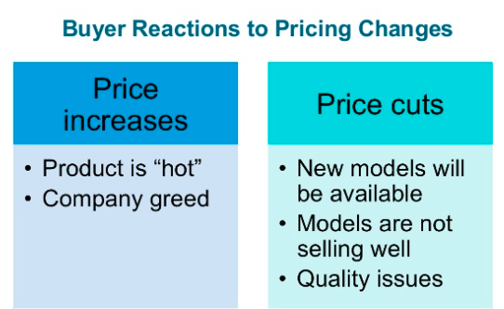
Price Changes

