Slide 1
Advertising, Public Relations & Sales Promotions
Chapter 15 & 16

Slide 2
Definition
Advertising
  Any paid form of nonpersonal presentation and promotion of ideas, goods, or services by an identified sponsor.

Slide 3
Major Advertising Decisions
Message Decisions
Message Strategy
Message Execution
Objectives Setting
Communication objectives
Sales Objectives
Budget Decisions
Affordable Approach
Percent of sales
Competitive parity
Objective and task
Campaign Evaluation
Communication Impact
Sales Impact
Media Decisions
Reach, Frequency, Impact
Major Media Types
Specific Media Types
Media Timing

Slide 4
Four important decisions in developing advertising program
Setting advertising objectives
Setting the advertising budget
Developing the advertising strategy
Evaluating advertising campaigns

Slide 5
Setting Advertising Objectives
Advertising objectives can be classified by primary purpose:
  Inform
    Introducing new products, suggesting new uses, informing price change etc.
  Persuade
    Becomes more important as competition increases [Sony offers best quality]
    Comparative advertising [We’re number two, so we try harder]
  Remind
    Most important for mature products [Coca-Cola]
    Reminding customers where to buy it

Slide 6
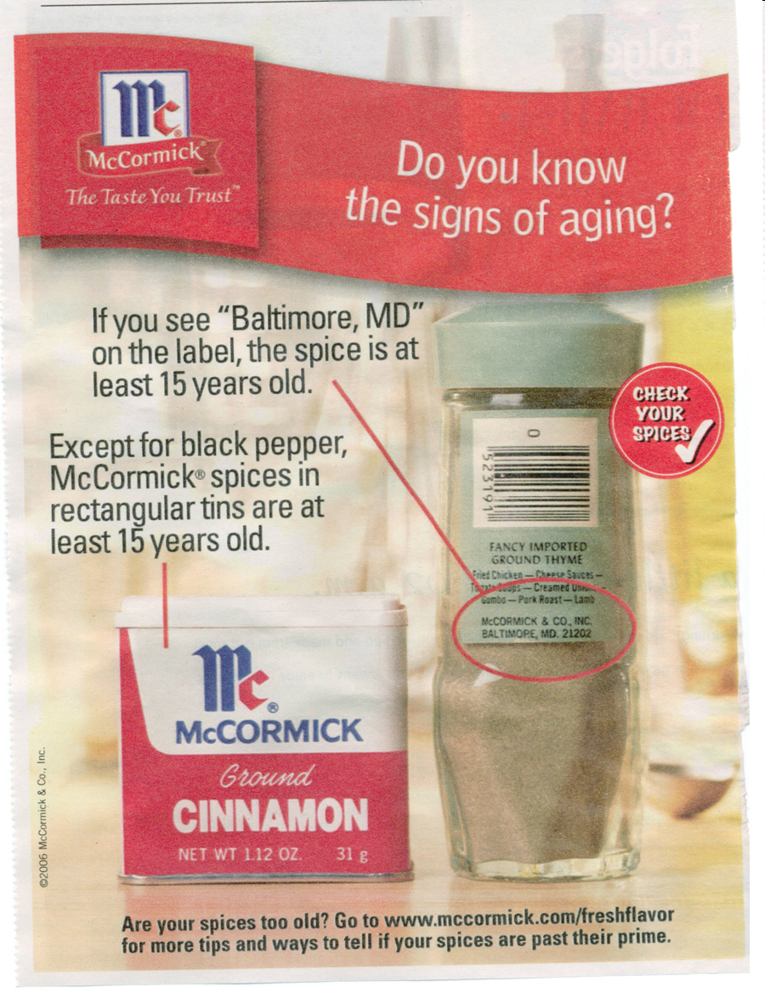
Informing

Slide 7
Setting the advertising budget
Several factors should be considered when setting the ad budget:
  Stage in the PLC: New products, big ad budget to aware and persuade; mature brands - low
  Market share: building the market or taking market share requires large ad budget.
  Level of competition: many competitors - large
  Ad clutter: high - large
  Degree of brand differentiation: undifferentiated brand – heavy ad budget

Slide 8
Developing advertising strategy
Two major elements:
  Creating ad messages
  Selecting ad media
Creating ad messages: increase number of TV channels, average ad expose numbers, remote control etc.
  Message strategy: what general message to be communicated?
    Advertising appeal: Three characteristics: appeals must be
      Meaningful: pointing out benefits
      Believable: deliver promised benefits
      Distinctive: how better than the competing brands?

Slide 9
Developing advertising strategy
  Message execution: Turn big idea into actual ad execution that will capture target market’s attention and interest. Creative people must find the best style, tone, words, and format for executing the message.
    Many execution styles: slice of life, musical, personality symbol, scientific evidence.
    Tone: +ve or –ve tone
    Words: “Buy cheap socks and you’ll pay through the toes” Hanes Socks.
    Format: Illustration, headline, copy

Slide 10
Developing advertising strategy
Select advertising media: Major steps in media selection are
  Decide on level of reach, frequency and impact:
  Choose among the major media types by considering:
    Target consumer media habits, nature of the product: fashion are best advertised in color magazines, auto performance on TV
    Types of messages: major sale – news paper, lots of technical data - magazine, and
    Costs: the cost of reaching 1,000 people using the media.
  Select specific media vehicles: specific media within each general media type. nTV, ATN Bangla; Ittefaq, Times, Daily Star, Independence.
  Decide on media timing: Hallmark – occasions, Even continuity or uneven Pulsing.

Slide 11
Advertising
Major Media Types
Newspapers
Television
Direct Mail
Radio
Magazines
Outdoor
Internet

Slide 12
Definition
  Public Relations
    Building good relations with the company’s various publics by obtaining favorable publicity, building up a good corporate image, and handling or heading off unfavorable rumors, stories, and events.

Slide 13
Major functions of public relations
Press Relations or Agency - creating and placing newsworthy information in the media
Product Publicity - publicizing specific products
Public Affairs - building and maintaining national or local community relations (e.g. sponsoring concerts)
Lobbying - building and maintaining relations with legislators and government officials

Slide 14
Major functions of public relations
Investor Relations - maintaining relationships with shareholders and others in the financial community
Development - maintaining relationships with donors or members of not-for-profit organizations
Crisis Management - helping a company in the media spotlight because of a problem with product, employees, or business

Slide 15
Public Relation Tools
Speeches
Press Conference/Press Release
Corporate Materials
Corporate Presentations
CSR Activities
Newsletters/Brochures/Printed Materials
Corporate Events

Slide 16
Definition
Sales Promotion
  Short-term incentives to encourage the purchase or sale of a product or service.
  Can be targeted at final buyers, retailers and wholesalers, business customers, and the sales force.

Slide 17
Consumer Promotion Tools
Samples: Lifebuoy mini pack shampoo.
Coupon: certificates, save $10 when you purchase with certificates
Cash Refunds (Rebates): Dell, mailing rebates
Price packs (cents-off deals): reduced price marked on the label or package. “two for the price of one”
Contests: suggestions, filling up essay, Games etc.

Slide 18
Consumer Promotion Tools
Advertising Specialties: articles imprinted with advertiser’s name. pens, calendars, key rings, matches, T shirts, caps, coffee mugs.
Premiums: goods offered either free or at low cost. (Gold or silver)
Patronage Rewards: frequent flier-programs
Point-of-Purchase Communications: Display at pop. Big Lipstick, Burger picture.

