Slide 1
Chapter 1
Consumer Behavior: Its Origins and Strategic Appliances

Slide 2
Why Study Consumer Behavior?
What consumers think of our products and those of our competitors
What they think of possible improvements in our products
How they use our products
What attitudes they have about our products and our advertising
What they feel about their roles in the family and society
What their hopes and dreams are for themselves and for their families

Slide 3
Consumer Behavior
The behavior that consumers display in searching for, purchasing, using, evaluating, and disposing of products and services that they expect will satisfy their needs.

Slide 4
Personal Consumer
The individual who buys goods and services for his or her own use, for household use, for the use of a family member, or for a friend.

Slide 5
Organizational Consumer
A business, government agency, or other institution (profit or nonprofit) that buys the goods, services, and/or equipment necessary for the organization to function.

Slide 6
Development of the Marketing Concept
Production
Concept
Product Concept
Selling Concept
Marketing
Concept

Slide 7
The Production Concept
Assumes that consumers are interested primarily in product availability at low prices
Marketing objectives:
Cheap, efficient production
Intensive distribution
Market expansion

Slide 8
The Product Concept
Assumes that consumers will buy the product that offers them the highest quality, the best performance, and the most features
Marketing objectives:
Quality improvement
Addition of features
Tendency toward Marketing Myopia

Slide 9
The Selling Concept
Assumes that consumers are unlikely to buy a product unless they are aggressively persuaded to do so
Marketing objectives:
Sell, sell, sell
Lack of concern for customer needs and satisfaction

Slide 10
The Marketing Concept
Assumes that to be successful, a company must determine the needs and wants of specific target markets and deliver the desired satisfactions better than the competition
Marketing objectives:
Profits through customer satisfaction

Slide 11
The Marketing Concept
A consumer-oriented philosophy that suggests that satisfaction of consumer needs provides the focus for product development and marketing strategy to enable the firm to meet its own organizational goals.

Slide 12
Implementing the Marketing Concept
Consumer Research
Segmentation
Targeting
Positioning

Slide 13
Segmentation, Targeting, and Positioning
Segmentation: process of dividing the market into subsets of consumers with common needs or characteristics
Targeting: selecting one or more of the segments to pursue
Positioning: developing a distinct image for the product in the mind of the consumer

Slide 14
Successful Positioning
Communicating the benefits of the product, rather than its features
Communicating a Unique Selling Proposition for the product

Slide 15
Successful Relationships
Customer
Value
Customer
Retention
Customer
Satisfaction

Slide 16
Types of Customers
Loyalists
Apostles
Defectors
Terrorists
Hostages
Mercenaries

Slide 17
Customer Profitability-Focused Marketing
Tier 1: Platinum
Tier 2: Gold
Tier 3: Iron
Tier 4: Lead

Slide 18
The Societal Marketing Concept
All companies prosper when society prospers
Companies, as well as individuals, would be better off if social responsibility was an integral component of every marketing decision
Requires all marketers adhere to principles of social responsibility

Slide 19
To Which Segment of Consumers Will This Ad Appeal?

Slide 20
A Segment of Consumers Who are Environmentally Concerned

Slide 21
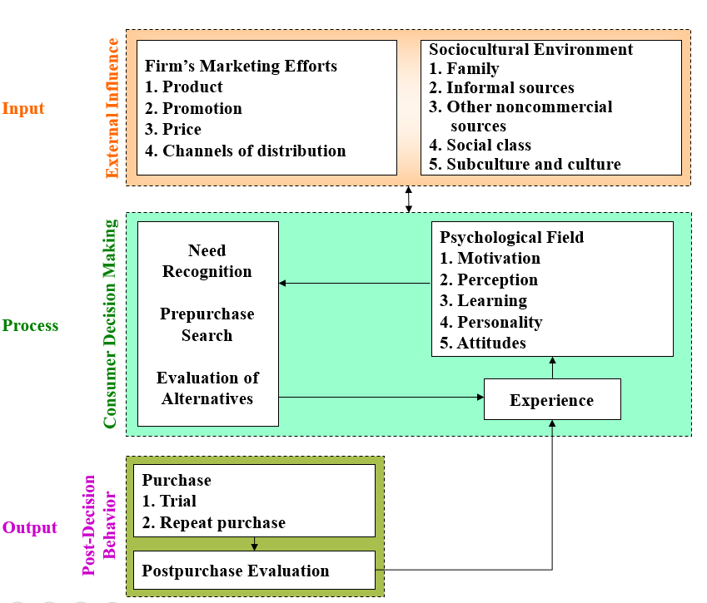
Model of Consumer Decision Making

