Slide 1
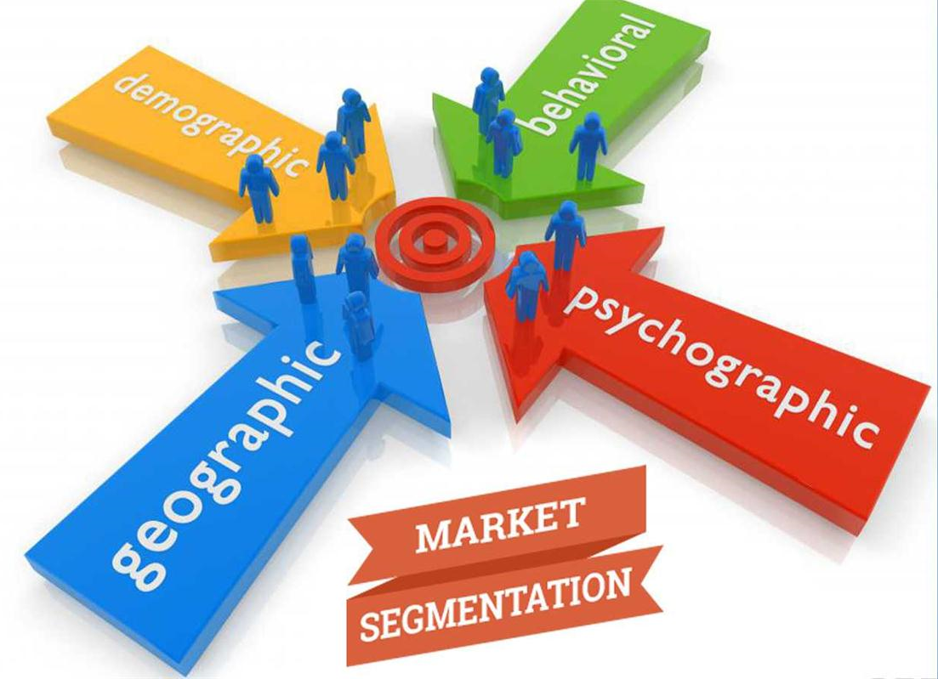
Market Segmentation ch 3

Slide 2
Chapter Outline
What Is Market Segmentation?
Bases for Segmentation
Criteria for Effective Targeting of Segments
Implementing Segmentation Strategies

Slide 3
Market Segmentation
The process of dividing a potential market into distinct subsets of consumers and selecting one or more segments as a target market to be reached with a distinct marketing mix.

Slide 4
Three Phases of Marketing Strategy
Phase 3
Product/Brand Positioning
Phase 2
Target Market and Marketing Mix Selection
Phase 1
Market Segmentation

Slide 5
Segmentation Studies
Discover the needs and wants of groups of consumers to develop specialized products to satisfy group needs
Used to identify the most appropriate media for advertising

Slide 6
Criteria for Effective Targeting of Market Segments
Identifiable
Sizable
Stable
Accessible
Congruent with the company’s objectives and resources

Slide 7
Bases for Segmentation
Geographic
Demographic
Psychological
Psychographic
Sociocultural
Use-Related
Usage-Situation
Benefit Sought
Hybrid

Slide 8
Table: Market Segmentation
SEGMENTATION BASE
SELECTED SEGMENTATION VARIABLES
Geographic Segmentation
Region
Southwest, Mountain States, Alaska, Hawaii
City Size
Major metropolitan areas, small cities, towns
Density of area
Urban, suburban, exurban, rural
Climate
Temperate, hot, humid, rainy
Demographic Segmentation
Age
Under 12, 12-17, 18-34, 35-49, 50-64, 65-74, 75-99, 100+
Sex
Male, female
Marital status
Single, married, divorced, living together, widowed
Income
Under $25,000, $25,000-$34,999, $35,000-$49,999, $50,000-$74,999, $75,000-$99,999, $100,000 and over
Education
Some high school, high school graduate, some college, college graduate, postgraduate
Occupation
Professional, blue-collar, white-collar, agricultural, military

Slide 9
Table continued
SEGMENTATION BASE
SELECTED SEGMENTATION VARIABLES
Psychological Segmentation
Needs-motivation
Shelter, safety, security, affection, sense of self-worth
Personality
Extroverts, novelty seeker, aggressives, innovators
Perception
Low-risk, moderate-risk, high-risk
Learning-involvement
Low-involvement, high-involvement
Attitudes
Positive attitude, negative attitude
Psychographic
(Lifestyle) Segmentation
Economy-minded, couch potatoes, outdoors enthusiasts, status seekers
Sociocultural Segmentation
Cultures
American, Italian, Chinese, Mexican, French, Pakistani
Religion
Catholic, Protestant, Jewish, Moslem, other
Subcultures (Race/ethnic)
African American, Caucasian, Asian, Hispanic
Social class
Lower, middle, upper
Family life cycle
Bachelors, young married, full nesters, empty nesters

Slide 10
Table continued
SEGMENTATION BASE
SELECTED SEGMENTATION VARIABLES
Use-Related Segmentation
Usage rate
Heavy users, medium users, light users, non users
Awareness status
Unaware, aware, interested, enthusiastic
Brand loyalty
None, some, strong
Use-Situation Segmentation
Time
Leisure, work, rush, morning, night
Objective
Personal, gift, snack, fun, achievement
Location
Home, work, friend’s home, in-store
Person
Self, family members, friends, boss, peers
Benefit Segmentation
Convenience, social acceptance, long lasting, economy, value-for-the-money
Hybrid Segmentation
Demographic/
Psychographics
Combination of demographic and psychographic profiles of consumer segments profiles
PRIZM NE Geodemographics
“Movers & Shakers,” “New Empty Nests,” “Boomtown Singles,” “Bedrock America”
SRI VALSTM
Innovators, Thinkers, Believer, Achievers, Strivers, Experiencer, Makers, Survivors

Slide 11
Geographic Segmentation
The division of a total potential market into smaller subgroups on the basis of geographic variables (e.g., region, state, or city)

Slide 12
Demographic Segmentation
Age
Sex
Marital Status
Income, Education, and Occupation

Slide 13
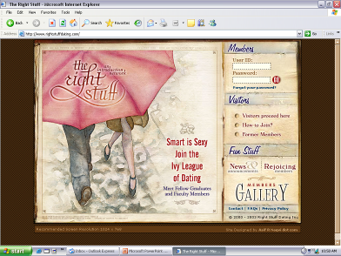
Web sites for Singles Looking for a Match
weblink
weblink
Match.com targets all singles
The Right Stuff targets only Ivy League graduates

Slide 14
Psychological Segmentation
Motivations
Personality
Perceptions
Learning
Attitudes

Slide 15
Two High-End Watches for Different Psychological Segments

Slide 16
Psychographic Segmentation
Also known as Lifestyle Analysis
Psychographic variables include attitudes, interests, and opinions (AIOs)

Slide 17
Sociocultural Segmentation
Family Life Cycle
Social Class
Culture, Subculture, and Cross-Culture

Slide 18
Family Life Cycle Advertising
Video cameras are often purchased by young couples with children.

Slide 19
Use-Related Segmentation
Rate of Usage
Heavy vs. Light
Awareness Status
Aware vs. Unaware
Brand Loyalty
Brand Loyal vs. Brand Switchers

Slide 20
Usage-Situation Segmentation
Segmenting on the basis of special occasions or situations
Example Statements:
Whenever our daughter Jamie gets a raise, we always take her out to dinner.
When I’m away on business, I try to stay at Sheraton
I always buy my wife flowers on Valentine’s Day.

Slide 21
Benefit Segmentation
Segmenting on the basis of the most important and meaningful benefit

Slide 22
Band-aid offers “flex” as a
benefit to consumers.

Slide 23
Hybrid Segmentation Approaches
Psychographic-Demographic Profiles
Geodemographic Segmentation
SRI Consulting’s VALS

Slide 24
Implementing Segmentation Strategies
Concentrated Marketing
A strategy whereby a product is developed and marketed for a very well defined and specific segment of the consumer population.
Differentiated Marketing
A sales growth strategy in which several market niches or population segments are targeted with different products for each niche or segment
Notes:
Note:
Differentiated Marketing: A differentiated marketing strategy is when a company creates campaigns that appeal to at least two market segments or target groups. For example, a store can promote a sale that appeals to people in at least two cities or locations, or a company can market a product that appeals to women in at least two age groups.
Concentrated Marketing:
Concentrated Marketing is a strategy whereby a product is developed and marketed for a very well defined and specific segment of the consumer population.
It is also called Niche marketing

Slide 25
Implementing Segmentation Strategies
Countersegmentation
Companies need to reconsider segmentation periodically
Two or more segments can be combined and targeted with a redesigned marketing mix

