Slide 1
Consumer Learning
CHAPTER
SEVEN

Slide 2
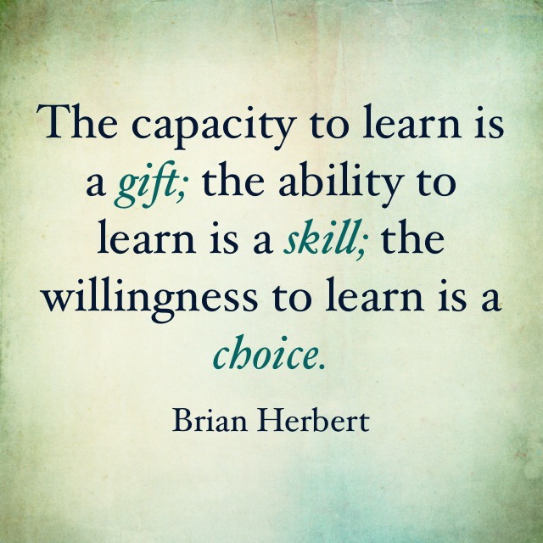
Learning

Slide 3
Learning
Applying past knowledge and experience to present circumstances and behavior
Permanent change in behavior caused by experience and knowledge
Can be voluntary or involuntary
Ongoing process

Slide 4
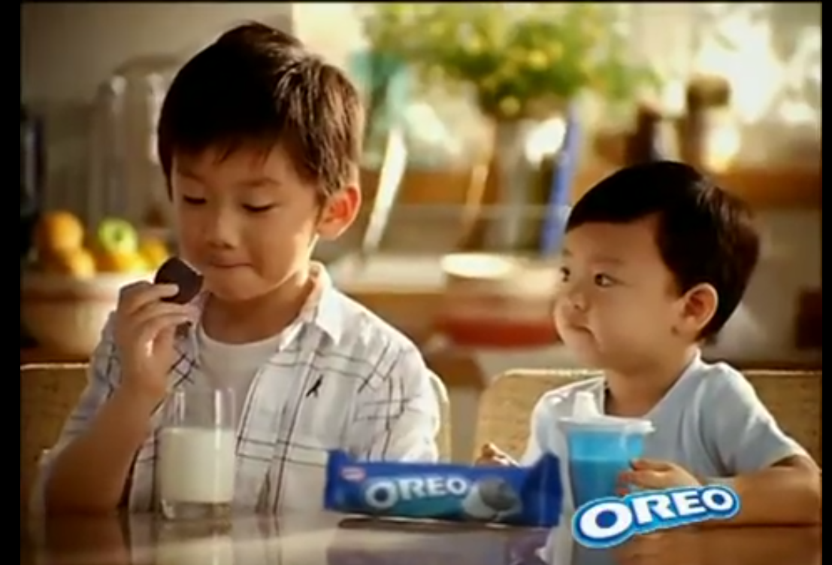
Learning
The process by which individuals acquire the purchase and consumption knowledge and experience that they apply to future related behavior
Consumer learning is a process that evolves and changes as consumers acquire knowledge from experience, observation and interactions with others
Marketers must teach consumers:
where to buy
how to use
how to maintain
how to dispose of products
Chapter Seven Slide
Notes:
This definition of learning can be looked at more specifically. It is important to realize that it is a process, that it changes over time as new knowledge and experiences are gained by the consumer. New knowledge and experience serve as feedback to the consumer and will influence their future behavior.

Slide 5
Elements of Learning Theories
Motivation
Cues
Response
Reinforcement
Unfilled needs lead to motivation
Stimuli that direct motives
Consumer reaction to a drive or cue
Increases the likelihood that a response will occur in the future as a result of a cue
Price, styling, packaging, advertising, store displays
Reward, benefit, pleasure, enjoyment
Chapter Seven Slide
Notes:
There are the four major elements of all learning theories. Motivation is important because it will differ from one consumer to the next. We may all have a need, but some are more motivated to fulfill the need versus another. Often, a consumer does not realize they have a need. A cue is the stimulus that helps direct a consumer’s motives. They include price, styling, packaging, advertising, and store displays. A consumer will have a response to a drive or a cue. The response is how the consumer behaves after being exposed to a cue or developing motivation. Finally, reinforcement is tied to the likelihood that the response will occur in the future.

Slide 6
Two Major Learning Theories
Behavioral Learning
Based on observable behaviors (responses) that occur as the result of exposure to stimuli
Cognitive Learning
Learning based on mental information processing
Often in response to problem solving
Chapter Seven Slide
Notes:
These are the two general categories of learning that will be discussed in this chapter. Each is covered in extensive detail on future slides.

Slide 7
Behavioral Learning
Classical Conditioning
Instrumental (Operant) Conditioning
Modeling or Observational Learning
Chapter Seven Slide
Notes:
In behavioral learning, it is classical conditioning and instrumental conditioning that are the two most researched, explored, and applied within consumer behavior.

Slide 8
A behavioral learning theory according to which a stimulus is paired with another stimulus that elicits a known response that serves to produce the same response when used alone.
Classical Conditioning
Chapter Seven Slide
Notes:
Many of you may be familiar with Pavlov’s dog. In this situation, Pavlov sounded a bell, then applied meat paste to the dog’s tongue. Over time, the dog began to associate the bell with the meat paste. Eventually, when Pavlov rang the bell, the dog would salivate because he expected the meat paste to be applied. What happened was learning or conditioning. The dog learned that the meat paste, which is called the unconditioned stimulus, was associated with the bell, which is the conditioned stimulus. He began to have a conditioned response to the bell when he learned that the bell meant food. The experiment is provided in more detail on the following slide.

Slide 9
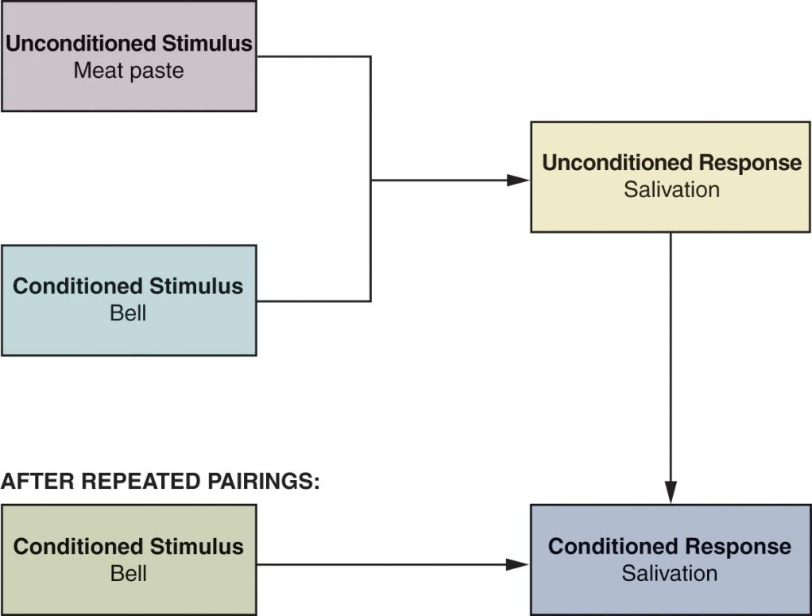
Models of Classical Conditioning
https://www.youtube.com/watch?v=asmXyJaXBC8
Chapter Seven Slide
Notes:
This is Pavlov’s experiment. As explained on the previous slide, the dog learned, was conditioned, to salivate from the bell after it was repeatedly paired with the unconditioned stimulus of the meat paste.

Slide 10
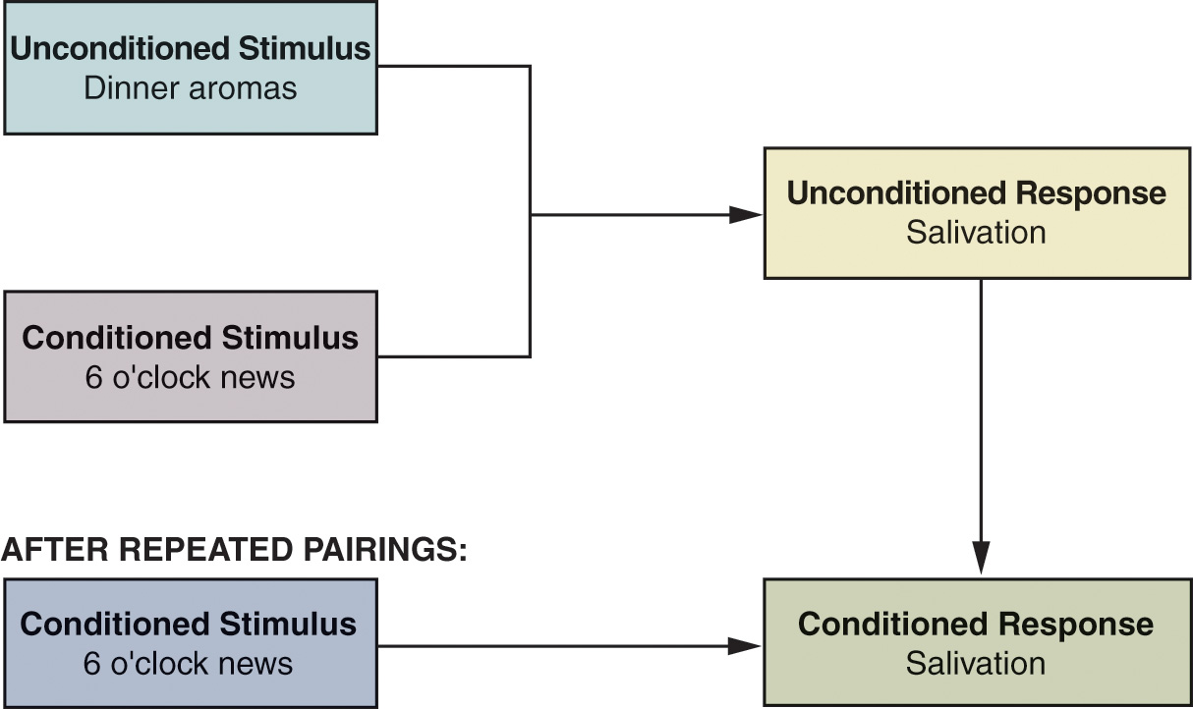
Models of Classical Conditioning
Chapter Seven Slide
Notes:
Here is another example of how classical conditioning might work. Why are dinner aromas an unconditioned stimulus? Why is salivation an unconditioned response? Do you often get hungry when you watch television?

Slide 11
Strategic Applications of Classical Conditioning
Basic Concepts
Repetition increases strength of associations and
slows forgetting
but over time may result in advertising wearout.
Advertising wearout is a problem
Cosmetic variations
Repetition
Stimulus generalization
Stimulus discrimination
Chapter Seven Slide
Notes:
For the association between the unconditioned and the conditioned stimuli to become strong, the exposure to the pairing must be repeated. In addition, the repetition is important so that the association is remembered by the subject. Of course, too much repetition can also be a problem. Think of the ad you have just seen so many times you feel like you can’t stand to see it again. This advertising wearout can be a big problem for advertisers, which is why they change their ads frequently.

Slide 12
Strategic Applications of Classical Conditioning
Basic Concepts
The inability to perceive differences between slightly dissimilar stimuli.
Helps “me-too” products to succeed
Useful in:
Product Line, Form and Category Extensions
family branding
Licensing
Repetition
Stimulus generalization
Stimulus discrimination
Chapter Seven Slide
Notes:
Stimulus generalization is when a consumer applies a conditioned response to a stimulus that is not the same but is similar to a conditioned stimuli. An example you might recognize is when we react to someone in a certain way because they remind us of someone we know and have interacted with before. Stimulus generalization can be helpful as marketers extend their product line, product form, and product category.

Slide 13
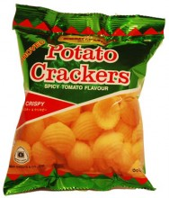
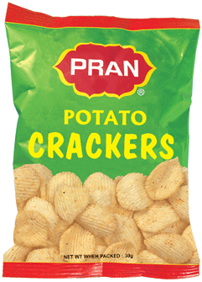
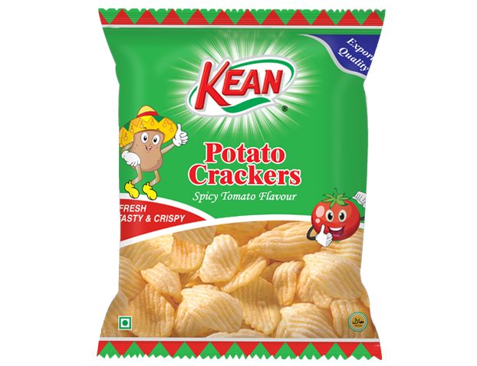
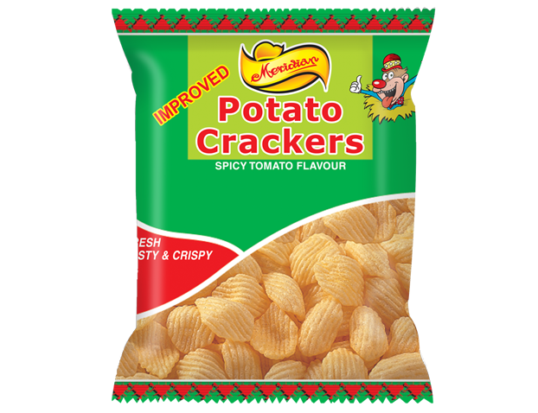

Slide 14
Strategic Applications of Classical Conditioning
Product form extension

Slide 15
Strategic Applications of Classical Conditioning
Product line extension

Slide 16
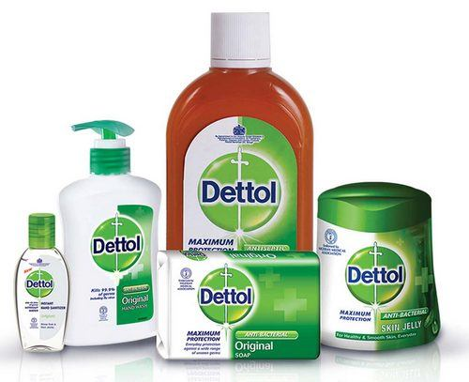
Family brand

Slide 17
Strategic Applications of Classical Conditioning
Basic Concepts
The ability to select a specific stimulus from among similar stimuli because of perceived differences.
This discrimination is the basis of positioning which looks for unique ways to fill needs
Repetition
Stimulus generalization
Stimulus discrimination
Chapter Seven Slide
Notes:
Stimulus discrimination is closely linked to the concept of positioning. Marketers want you to think of their product differently than the rest when you are looking at the shelf in the grocery store. Using the example of the brand Tylenol, the manufacturer would want you to know that it is superior to the store brand.

Slide 18
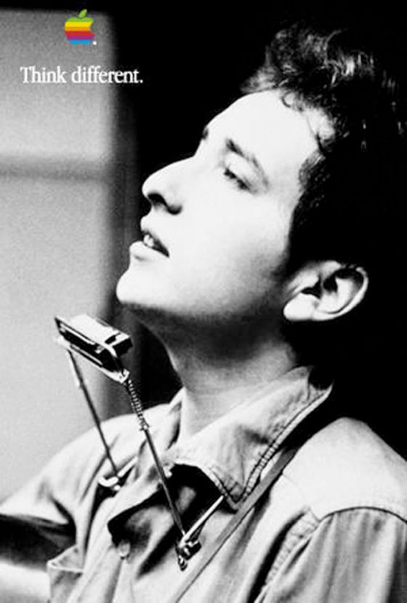
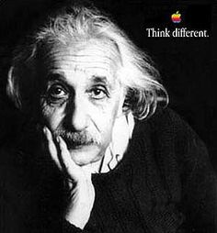
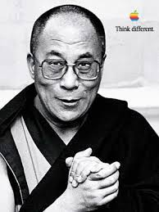
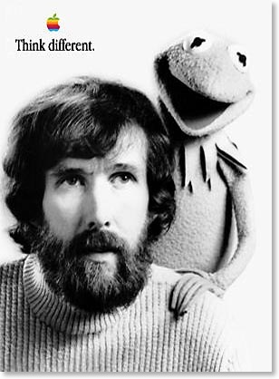

Slide 19
Instrumental (Operant) Conditioning
A behavioral theory of learning based on a trial-and-error process, with habits forced as the result of positive experiences (reinforcement) resulting from certain responses or behaviors.

Slide 20
Types of Reinforcement
Positive
Reward from a particular behavior
Negative
Removal of an unpleasant stimulus
Forgetting
Decay caused through passage of time
Extinction
Unreinforced behavior becomes unlearned

Slide 21
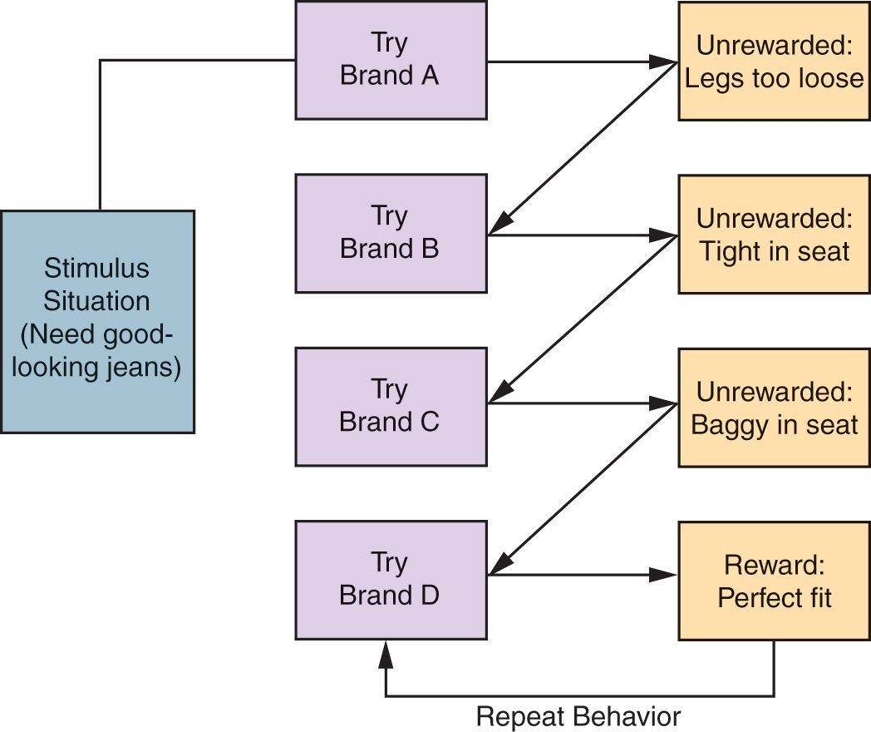
A Model of Instrumental Conditioning

Slide 22
Observational Learning
A process by which individuals observe how others behave in response to certain stimuli and reinforcements. Also known as modeling or vicarious learning.

Slide 23
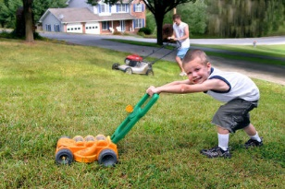
Observational Learning

Slide 24
Cognitive Learning Theory
Holds that the kind of learning most characteristic of human beings is problem solving, which enables individuals to gain some control over their environment.

Slide 25
Issues in Involvement Theory
Consumer Relevance
Central and Peripheral Routes to Persuasion

Slide 26
Consumer Relevance
Involvement depends on degree of personal relevance.
High involvement is:
Very important to the consumer
Provokes extensive problem solving

Slide 27
Central and Peripheral Routes to Persuasion
Central route to persuasion
For high involvement purchases
Requires cognitive processing
Peripheral route to persuasion
Low involvement
Consumer less motivated to think
Learning through repetition, visual cues, and holistic perception

